Slide 1
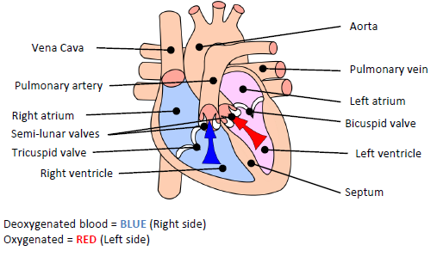
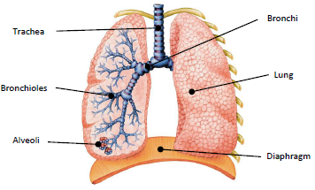
Blood Vessels
Y9 Knowledge Organiser 2 – RO43 The Body’s Response to Physical Activity
Structure of the Cardiovascular System
Functions of the Cardio-Vascular System
2 | Veins | - Carry blood back IN to the heart - Deoxygenated blood (except pulmonary vein) - Thin walls + larger lumen
3 | Arteries | - Carry blood Away from the heart - Oxygenated blood(except pulmonary artery) - Thick/elastic walls
4 | Capillaries | Smallest and thinnest blood vessel Within tissue Site of gaseous exchange Very thin walls
1
9 | Transport Oxygen, CO2 & Nutrients
10 | Protect from infection
11 | Regulate body temp
12 | Regulate Fluid Levels
Respiratory System
Blood Cells
Cardio-Respiratory
5 | Red Blood Cells | - Carry oxygen from the lungs to the working muscles - Removes CO2
6 | White Blood Cells | -Part of the immune system Fight disease and infection
7 | Platelets | - Platelets clot blood and form a scab around the site of injury.
8 | Plasma | - Plasma is the liquid/fluid part of blood that allows it to flow.
9 | Heart Rate | The amount of beats the heart can pump per minute (BPM)
10 | Cardiac Output | The amount of blood the heart pumps out per minute.
11 | Stroke Volume | The amount of blood the heart pumps out per beat.
12 | Vascular Shunt Mechanism | The re-distribution of blood around the body during exercise.
13 | Trachea | Windpipe. Air travels down towards the bronchi.
14 | Bronchi | A tube leading from the trachea to a lung, which provides for the passage of air.
15 | Bronchioles | A narrow tube inside the lungs that branches off the main air passages bronchi.
16 | Diaphragm | A curved muscular membrane that separates the abdomen from the area around the lungs.
17 | Alveoli | A tiny thin-walled air sac found in large numbers in each lung, through which oxygen enters and carbon dioxide leaves the blood.

