Slide 1
Week 5
Underlined dates and titles?
Examples in red bubbles?
Completed feedback?
Correct spellings?
Completed unfinished work?
Updated tracker?
Marked classwork?
COPS COMPLETE

Slide 2
Substitute

Slide 3
Read it:
Substitute
Define it:
"Substitute" means to put in the place of another.
Deconstruct it:
Latin
Sub = under
Submerge, Subject
Example:
Digging Deeper:
A person or thing acting or serving in place of another.
"soya milk is used as a substitute for dairy milk"
Link it:
Replacement, Exchange, Switch

Slide 4
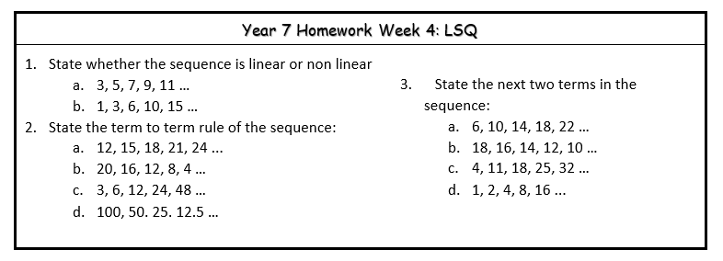
Homework
LAST WEEK: LSQ
ANSWERS

Slide 5
Homework
THIS WEEK: KNOWLEDGE ORGANISER

Slide 6
Week 5
Tuesday

Slide 7
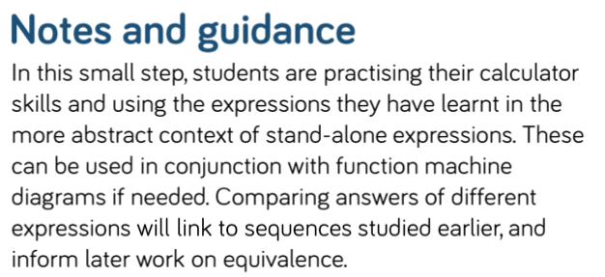
Substitute into a Single Expressions
To be able to substitute into a single expression
Expression, Evaluate, Substitute

Slide 8
Substitute into a Single Expressions
Discussion
Addition is Commutative
Subtraction is not Commutative
Commutative means to give the same result

Slide 9
Substitute into a Single Expressions
Discussion

Slide 10
Substitute into a Single Expressions

Slide 11
Substitute into a Single Expressions
4

Slide 12
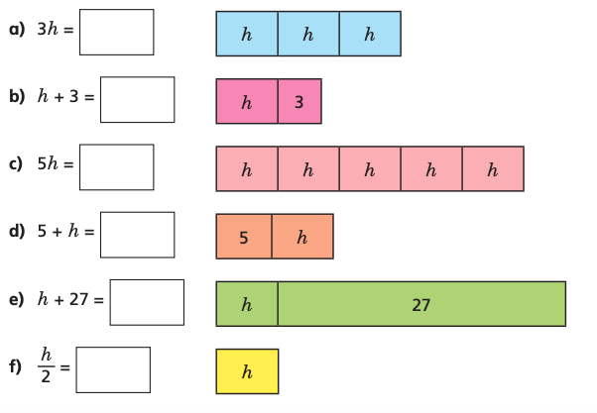
Substitute into a Single Expressions
h = 7
h = 12
h = 19
h = 15.5

Slide 13
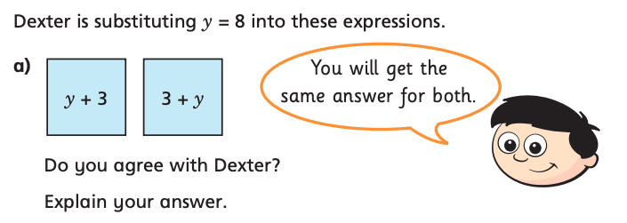
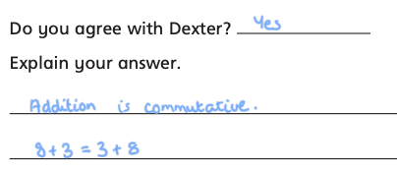
Substitute into a Single Expressions

Slide 14
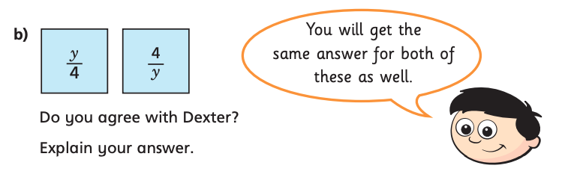
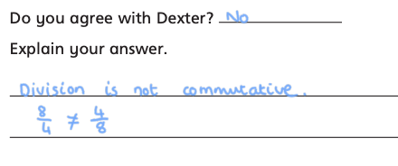
Substitute into a Single Expressions

Slide 15
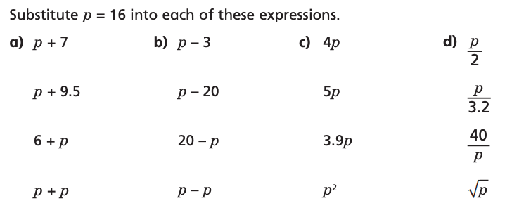
Substitute into a Single Expressions

Slide 16
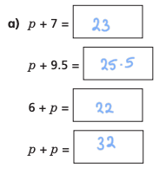
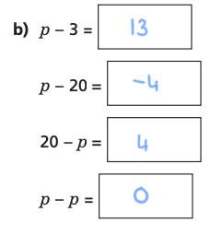
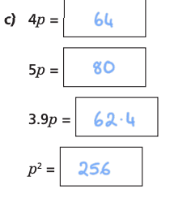
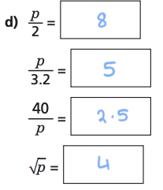
Substitute into a Single Expressions

Slide 17
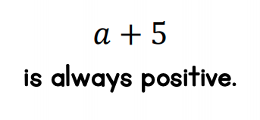
True or False?

Slide 18
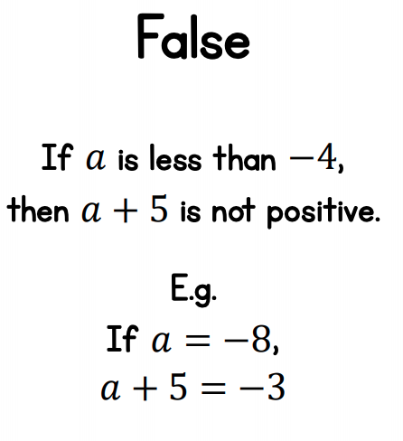
True or False?

Slide 19
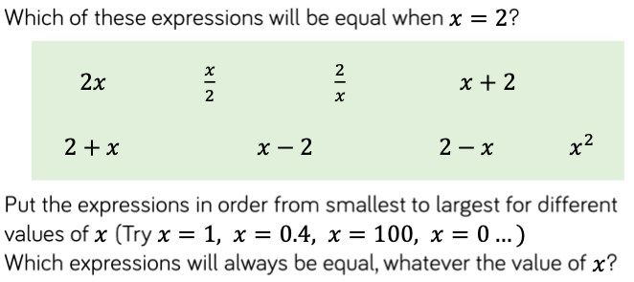
Substitute into a Single Expressions

Slide 20
Week 5
Wednesday

Slide 21
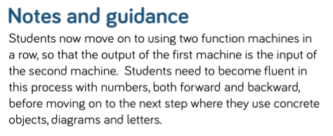
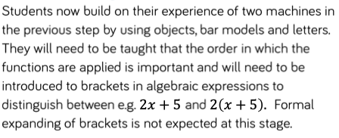
2 Step Function Machines
To be abe to calculate the ouput and input of 2 step function machines using number and algebra
Input, Output, Inverse, Expression, Evaluate

Slide 22
2 Step Function Machines

Slide 23
2 Step Function Machines

Slide 24
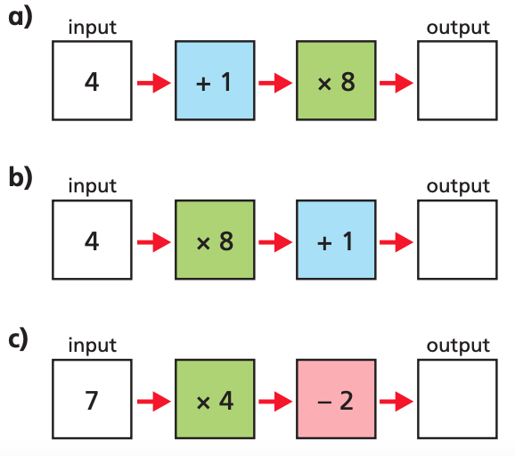
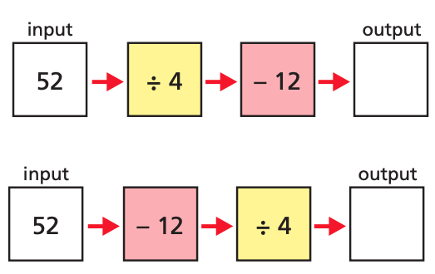
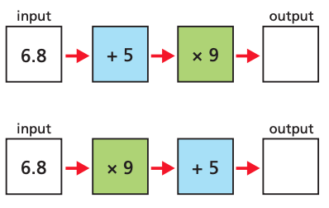
2 Step Function Machines
40
33
26
20
1
10
106.2
66.2

Slide 25
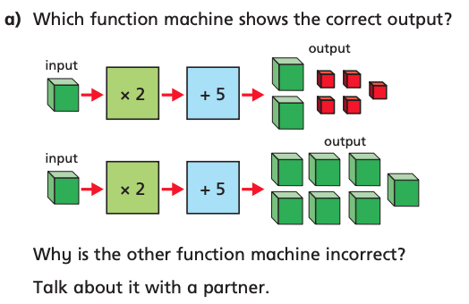
2 Step Function Machines
Discussion

Slide 26
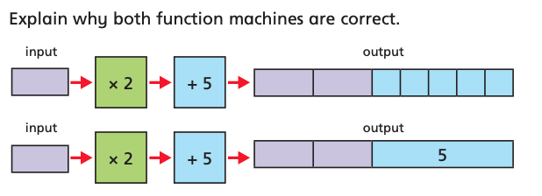
2 Step Function Machines
Whiteboards

Slide 27
2 Step Function Machines

Slide 28
2 Step Function Machines
m + 1 x 4
4m + 4

Slide 29
2 Step Function Machines

Slide 30
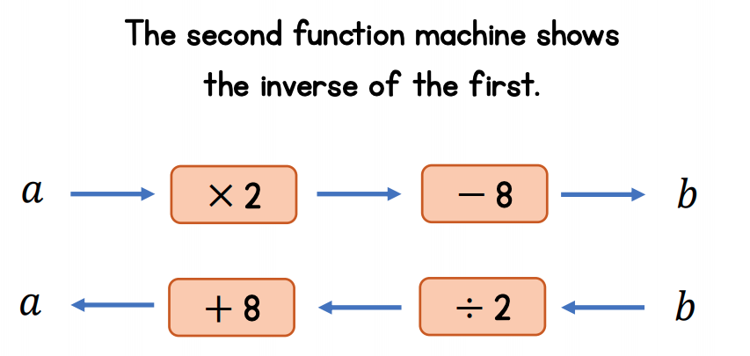
2 Step Function Machines

Slide 31
2 Step Function Machines

Slide 32
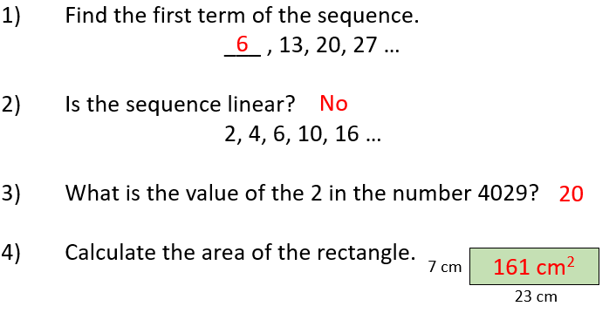
Week 5
Thursday

Slide 33
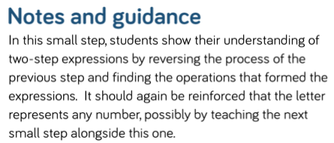
Finding Functions from Expressions
To be abe to find functions from an expression
Input, Output, Bracket, Expression, Variable

Slide 34
Finding Functions from Expressions

Slide 35
Finding Functions from Expressions

Slide 36
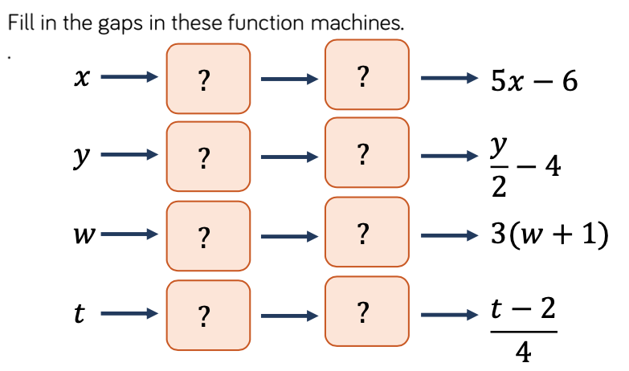

Slide 37
Finding Functions from Expressions
and
What is the same and what is different?

Slide 38
Finding Functions from Expressions

Slide 39
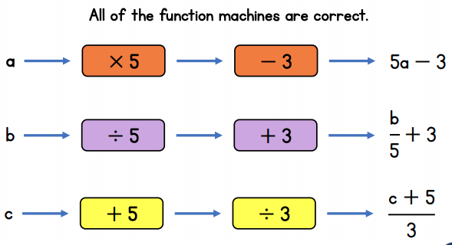
True or False?

Slide 40
True or False?

Slide 41
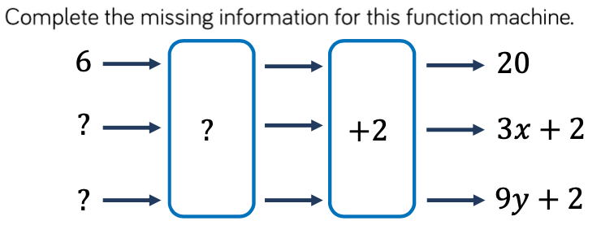
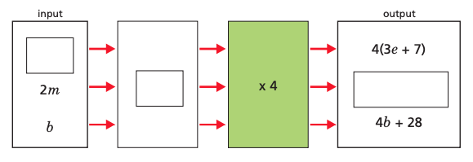
Finding Functions from Expressions

Slide 42
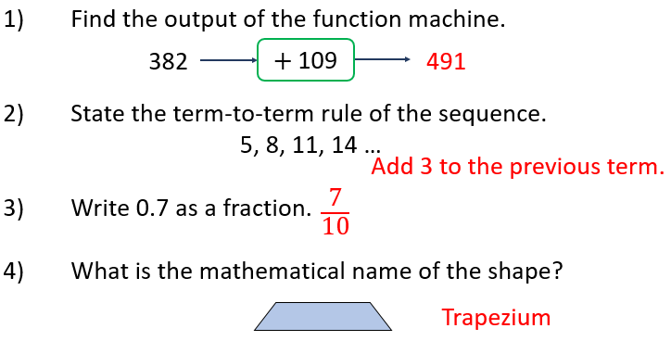
Week 6
Tuesday

Slide 43
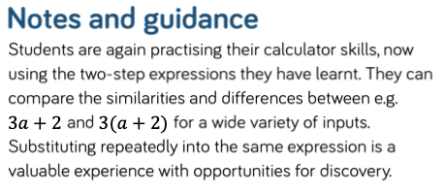
Substitute into a Two Step Expression
To be abe to substitute into a two step expression
Input, Output, Bracket, Substitute, Variable

Slide 44
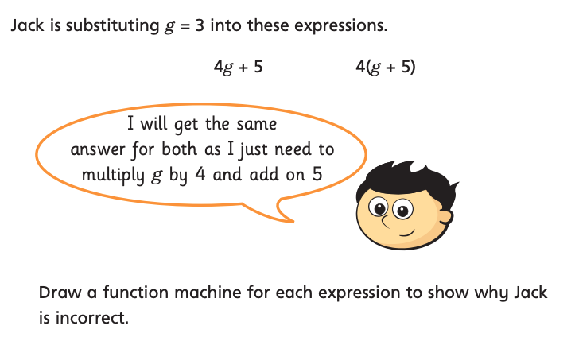
Substitute into a Two Step Expression
Whiteboards - Discover

Slide 45
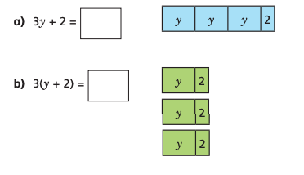
Substitute into a Two Step Expression

Slide 46
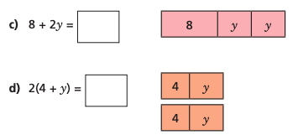
Substitute into a Two Step Expression

Slide 47
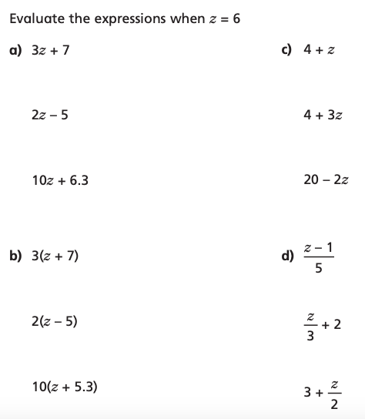
Substitute into a Two Step Expression
Dora has made a mistake.
What calculation should Dora have completed first? Correct her working out.
What would the expression need, for the answer 144 to be correct?

Slide 48
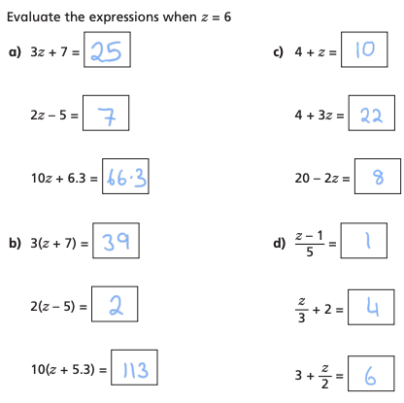
Substitute into a Two Step Expression
a) Should have squared the 3 first (BIDMAS)
b)

Slide 49
If $h=4$ and $c=1$, work out the value of:
$$2h+4c$$
$$5h−3c$$

Slide 50
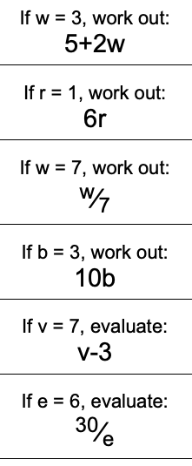
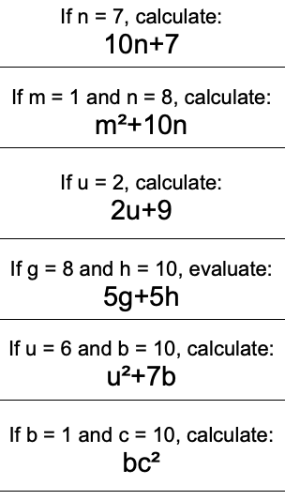
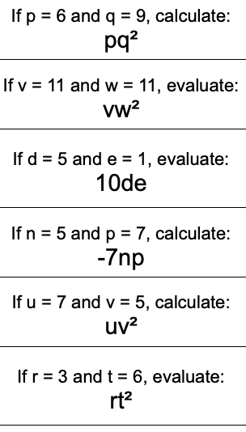
My Question

Slide 51
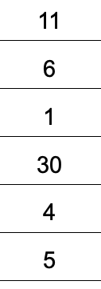
Answers

Slide 52
Substitute into a Two Step Expression
Whiteboards
4
6
1.5
-7

