Slide 1
Year 8 DO NOW Week 4
Year 8 Skills: Monday
Work out:
$$\frac{1}{4} ÷ 2 =$$
$$\frac{1}{8}$$
$$\frac{1}{10}$$
$$\frac{1}{4} ÷ 1 =$$
$$\frac{1}{4}$$
$$\frac{1}{5}$$
$$\frac{2}{5} ÷ 2 =$$
$$\frac{3}{10} ÷ 3 =$$
$$\frac{2}{8} ÷ 4 =$$
$$\frac{2}{10} ÷ 4 =$$
$$\frac{6}{8} ÷ 2 =$$
$$\frac{3}{8}$$
$$\frac{3}{25}$$
$$\frac{1}{8}$$
$$\frac{3}{8}$$
$$\frac{1}{20}$$
$$\frac{1}{8}$$
$$\frac{3}{4} ÷ 2 =$$
$$\frac{2}{4} ÷ 4 =$$
$$\frac{3}{5} ÷ 5 =$$

Slide 2
Week 4
Underlined dates and titles?
Examples in red bubbles?
Completed feedback?
Correct spellings?
Completed unfinished work?
Updated tracker?
Marked classwork?
COPS COMPLETE

Slide 3
Equivalent

Slide 4
Read it:
Equivalent
Define it:
When something is equivalent it has the same value.
Deconstruct it:
Equivalent has Latin roots and is split into two root words, "equal" and "value”, which is why it is defined as the same value.
Example
120 seconds is equivalent to 2 minutes.
Digging Deeper:
Equivalent is not only used in maths but has the same meaning:
‘He runs the equivalent of three marathons a week.’
Link it:
Equal, Same, Corresponding, Alike

Slide 5
Homework
LAST WEEK: READING

Slide 6
Homework
LAST WEEK: READING

Slide 7
Homework
THIS WEEK: LSQ
Answer these questions for your homework.
We will mark them next week in class.

Slide 8
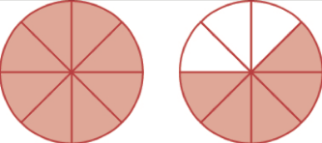
Year 8 DO NOW Week 4
Year 8 Skills: Tuesday
Writing mixed numbers:
$3\frac{5}{6}$
$1\frac{5}{8}$
Adding Fractions:
$$\frac{1}{8}+\frac{3}{4} =$$
$$\frac{7}{8}$$
$$2\frac{2}{5}$$
$$1\frac{6}{7}$$
$$\frac{2}{6} +\frac{2}{4} =$$
$$\frac{10}{12}$$
Subtracting Fractions:
$$\frac{1}{8} +\frac{1}{4} =$$
$$\frac{3}{8}$$
$$\frac{5}{8} −\frac{3}{4} =$$
$$\frac{2}{8}$$
$$\frac{2}{5} −\frac{1}{10} =$$
$$\frac{3}{10}$$

Slide 9
Indices
To be able to determine the notation that represents a repeated multiplication
Key words
Indices, Index, Power, Multiply, Simplify

Slide 10
Indices
Worked Example
Instead of writing out:
2 x 2 x 2 x 2 x 2 x 2 x 2 x 2
We can re-write it as $2^{8}$ as we are multiplying 2 by its self 8 times

Slide 11
Indices
Practice Questions
Simplify the following
$3×3×3×3$
$5×5×5×5×5×5×5$
$12×12×12×12×12×12×12×12×12$
Express the following
$3^{2}$
$6^{4}$
${15}^{7}$
Simplify the following
$2×2×2×5×5×5×5$
$7×3×7×3×7×3$
$1×4×2×1×2×2×4×4$
Simplify the following
$$2^{4}×2^{5}$$

Slide 12
Indices
Answers
Simplify the following
$3^{4}$
$5^{7}$
${12}^{9}$
Simplify the following
$2^{3}×5^{4}$
$3^{3}×7^{3}$
$1^{2}×2^{3}×4^{3}$
Express the following
$3×3$
$6×6×6×6$
$15×15×15×15×15×15×15$
Simplify the following
$$2^{9}$$

Slide 13
Indices
Progress Pit-stop!
Simplify the following
$$8×8×8×8×8$$
.
I don’t understand
I nearly understand
I fully understand

Slide 14
Indices
Worked Example
Indices are mad, when we times we add
$$3^{3}×3^{2}$$
$$3 ×3 ×3 ×3 ×3$$
So we can write $3^{3}×3^{2}=3^{5}$
$$3^{3}$$
$$3^{2}$$

Slide 15
Indices
Practice Questions
Simplify the following
$3^{2}×3$
$6^{3}×6^{5}$
Simplify the following
$8^{−5}×8^{−3}$
$2^{−1}×2^{−7}$
Simplify the following
$5^{4}×5^{−9}$
$4^{−3}×4^{8}$
Find the missing Indices
$2^{4}×2^{}=2^{6}$
$a^{}×a^{3}=a^{9}$
$b^{5}=b^{−3}×b^{}$

Slide 16
Indices
Answers
Simplify the following
$3^{3}$
$6^{8}$
Simplify the following
$8^{−8}$
$2^{−8}$
Simplify the following
$5^{−5}$
$4^{5}$
Find the missing Indices
$2^{4}×2^{2}=2^{6}$
$a^{6}×a^{3}=a^{9}$
$b^{5}=b^{−3}×b^{8}$

Slide 17
Indices
Progress Pit-stop!
Simplify the following
$$5^{2}×5^{3}$$
.
I don’t understand
I nearly understand
I fully understand

Slide 18
Indices
Worked Example
Indices are abstract, when we divide we subtract
$$4^{5}÷4^{4}$$
$$\frac{4×4×4×4×4}{4×4×4×4}=4$$
So we can write $4^{5}÷4^{4}=4$

Slide 19
Indices
Practice Questions
Simplify the following
$7^{5}÷7^{3}$
$3^{9}÷3^{2}$
Simplify the following
$9^{−2}÷9^{−5}$
$2^{−8}÷2^{−2}$
Simplify the following
$2^{7}÷2^{−1}$
$6^{−3}÷6^{4}$
Find the missing Indices
$7^{5}÷7^{}=7^{3}$
$a^{}÷a^{3}=a^{6}$
$b^{10}=b^{3}÷b^{}$

Slide 20
Indices
Answers
Simplify the following
$7^{2}$
$3^{7}$
Simplify the following
$9^{3}$
$2^{−6}$
Simplify the following
$2^{8}$
$6^{−7}$
Find the missing Indices
$7^{5}÷7^{2}=7^{3}$
$a^{9}÷a^{3}=a^{6}$
$b^{10}=b^{3}÷b^{−7}$

Slide 21
Indices
Progress Pit-stop!
Simplify the following
$${12}^{6}÷{12}^{2}$$
.
I don’t understand
I nearly understand
I fully understand

Slide 22
Indices
Standard Form
Standard form is a way of writing down very large or very small numbers easily. 10³ = 1000
4 × 10³ = 4000 .
So 4000 can be written as 4 × 10³
To use standard form the number before the powers of ten must be a number between 1 – 9, including decimals

Slide 23
Indices
Worked Example
$$3000×200000$$
$$3×{10}^{3}×2×{10}^{5}$$
$$3×2×{10}^{3}×{10}^{5}$$
$$6×{10}^{8}$$

Slide 24
Indices
Worked Example
$$600000÷2000$$
$$\frac{{6×10}^{5}}{2×{10}^{3}}$$
$$\frac{6}{2} ×\frac{{10}^{5}}{{10}^{3}}$$
$$3×{10}^{2}$$

Slide 25
Indices
Practice Questions
Simplify the following
$3×{10}^{3}×2×{10}^{2}$
$\frac{{8×10}^{6}}{4×{10}^{3}}$
Simplify the following
$4×{10}^{−6}×2×{10}^{−2}$
$\frac{{5×10}^{−6}}{2.5×{10}^{−3}}$
Simplify the following
$5×{10}^{6}×1×{10}^{−3}$
$\frac{{9×10}^{3}}{3×{10}^{−2}}$
Simplify the following
$4×{10}^{3}×3×{10}^{−2}$
$\frac{1.8×{10}^{6}}{9×{10}^{3}}$

Slide 26
Indices
Answers
Simplify the following
$6×{10}^{5}$
$2×{10}^{3}$
Simplify the following
$8×{10}^{−8}$
$2×{10}^{−3}$
Simplify the following
$5×{10}^{3}$
$3×{10}^{5}$
Simplify the following
$1.2×{10}^{2}$
$2×{10}^{2}$

Slide 27
Year 8 DO NOW Week 4
Year 8 Skills: Wednesday
Find the LCM:
2 and 8
4 and 6
3 and 8
Fraction of an amount:
$$\frac{7}{9}×9=$$
8
12
24
$$9×\frac{2}{3}=$$
$$20×\frac{7}{10}=$$
$$\frac{18}{3}= 6$$
$$\frac{140}{10}= 14$$
$$\frac{63}{9}= 7$$
Put the following in ascending order:
Arrange the following decimals in ascending order:
5.24 4.28 4.42 4.16
4.16, 4.28, 4.42, 5.24
0.54, 0.45, 0.37, 0.55, 0.21
2.3 2.4 2.8 3.7 2.9
0.21, 0.37, 0.45, 0.54, 0.55
2.3, 2.4, 2.9, 2.8, 2.9, 3.7

Slide 28
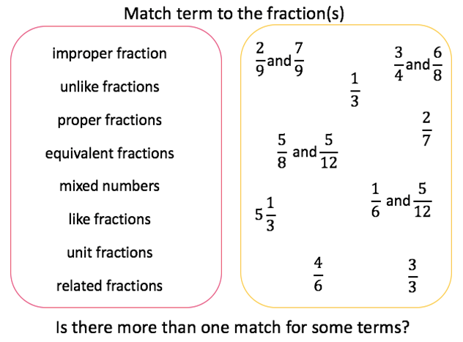
Fractions
To be able to compare fractions on a number line
To be able to compare fractions with unlike denominators
To be able to order fractions with unlike denominators
Key words
Mixed Number, Improper, Equivalent

Slide 29
Fractions
$$\frac{1}{2}$$
$$\frac{3}{4}$$

Slide 30
Fractions
Practice Questions
Compare the fractions below using >,< or =
Steps for success
Shade in the numerator (top number) for both fractions.
Compare the amounts for each circle.

Slide 31
Fractions
Answers
Compare the fractions below using >,< or =
$$<$$
Steps for success
Shade in the numerator (top number) for both fractions.
Compare the amounts for each circle.
$$<$$
$$=$$

Slide 32
Fractions
Progress Pit stop
Compare the fractions using >,< or =
.
I don’t understand
I nearly understand
I fully understand

Slide 33
Fractions
Compare the fractions below using >,< or =
$\frac{3}{4}$ $\frac{3}{8}$
$\frac{4}{5}$ $\frac{1}{2}$

Slide 34
Fractions
Use <,> or = to compare the following fractions

Slide 35
Fractions
Answers
$$>$$
$$=$$
$$>$$
$$<$$
$$>$$
$$>$$
$$>$$
$$<$$
$$>$$
$\frac{1}{8}$ , $\frac{1}{2}$ , $\frac{7}{16}$

Slide 36
Fractions
Progress Pit stop
Use <,> or = to compare the following fractions
$$\frac{3}{8} \frac{2}{4}$$
.
I don’t understand
I nearly understand
I fully understand

Slide 37
Fractions
Challenge
How could we order the following fractions?
1) $\frac{3}{8}$ , $\frac{7}{8}$ , $\frac{1}{8}$
2) $\frac{1}{8}$ , $\frac{1}{2}$ , $\frac{7}{16}$

Slide 38
Fractions
Order the following fractions:
$$\frac{2}{3},\frac{2}{6},\frac{5}{12}$$

Slide 39
Fractions
Practice Questions
1) $\frac{2}{3}$ , $\frac{1}{3}$ , $\frac{3}{3}$
2) $\frac{4}{5}$ , $\frac{6}{10}$ , $\frac{7}{15}$
3) $\frac{2}{6}$ , $\frac{5}{6}$ , $\frac{4}{12}$
4) $\frac{4}{5}$ , $\frac{7}{10}$ , $\frac{3}{5}$
$\frac{2}{3}$ , $\frac{4}{5}$ , $\frac{4}{7}$
5) $\frac{2}{3}$ , $\frac{1}{4}$ , $\frac{3}{12}$
6) $\frac{4}{5}$ , $\frac{6}{10}$ , $\frac{1}{2}$

Slide 40
Fractions
Answers
1) $\frac{2}{3}$ , $\frac{1}{3}$ , $\frac{3}{3}$
2) $\frac{4}{5}$ , $\frac{6}{10}$ , $\frac{7}{15}$
3) $\frac{2}{6}$ , $\frac{5}{6}$ , $\frac{4}{12}$
4) $\frac{4}{5}$ , $\frac{7}{10}$ , $\frac{3}{5}$
$\frac{2}{3}$ , $\frac{4}{5}$ , $\frac{4}{7}$
5) $\frac{2}{3}$ , $\frac{1}{4}$ , $\frac{3}{12}$
6) $\frac{4}{5}$ , $\frac{6}{10}$ , $\frac{1}{2}$

Slide 41
Year 8 DO NOW Week 4
Year 8 Skills: Thursday
Write the following
Numbers as the product
of prime factors:
Fraction of an amount:
2 x 3 x 3
3 x 13
2 x 2 x 2 x 2 x 3
18
39
48
4
$$4×\frac{1}{3}=\frac{}{3}$$
Round to a
whole number:
$$5×\frac{4}{5}=$$
$$3×\frac{2}{3}=$$
$$\frac{20}{5}=4$$
$$\frac{6}{3}=2$$
$$\frac{1}{3}×___=\frac{5}{3}$$
5
$$2.2=$$
$$9.4=$$
$$1.85=$$
2
9
2
$$2×\frac{}{}=\frac{6}{3}$$
3
3

Slide 42
Equivalent fractions
Understand what we mean by a fraction.
Be able to recap and identify fraction definitions.
Determine whether two fractions are equivalent.
Calculate fractions equivalent to another fraction.
Key words: Fraction, divide, numerator, denominator, equivalent, multiplier.

Slide 43
Equivalent fractions
Worked example:
Lets label the fraction with the following words:
Denominator
Numerator
Divide
$$\frac{1}{2}$$
Extension: Can you draw this fraction visually?

Slide 44
Equivalent fractions
Worked example:
Lets label the fraction with the following words:
Denominator
Numerator
Divide
$$\frac{1}{2}$$

Slide 45
Equivalent fractions
What fraction of each diagram is shaded?

Slide 46
Equivalent fractions
From the last slide we can say that:
$$\frac{1}{2}=\frac{2}{4}$$
$$\frac{1}{2}=\frac{4}{8}$$
$$\frac{1}{2}=\frac{5}{10}$$
$$\frac{1}{2}=\frac{10}{20}$$

Slide 47
Equivalent fractions
Example:
$$\frac{}{12}$$
$\frac{2}{3}$ =

Slide 48
Equivalent fractions
Example:
$$\frac{}{16}$$
$\frac{1}{8}$ =

Slide 49
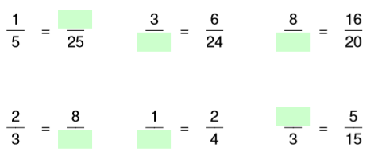
Progress pit stop
.

Slide 50
Progress pit stop
5
12
10
1
12
2
.

Slide 51
Equivalent fractions
Example:
Find a fraction equivalent to $\frac{3}{5}$

Slide 52
Equivalent fractions
Example:
Find a fraction equivalent to $\frac{2}{7}$

Slide 53
My Question
Find five different equivalent fractions for each of the fractions below:
$\frac{1}{3}$
$\frac{3}{10}$
c) $\frac{4}{7}$
d) $\frac{8}{13}$
2. Determine whether the pairs of fractions below are equivalent or not:
$$a) \frac{1}{2} and \frac{15}{30 }$$
$$c) \frac{2}{3} and \frac{16}{ 24 }$$
$$b) \frac{1}{4} and \frac{16}{48 }$$
$$d) \frac{3}{7} and \frac{36}{ 82 }$$
3.

Slide 54
Equivalent fractions
Equivalent fraction BINGO

Slide 55
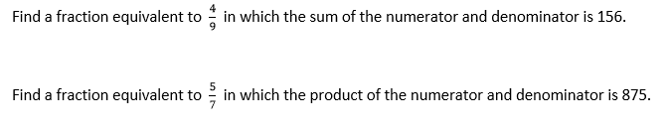
Purple Problem

Slide 56
Purple Problem
$$\frac{48}{108}$$
$$\frac{25}{35}$$

Slide 57
Fractions
Understand what we mean by a fraction.
Be able to recap and identify fraction definitions.
Determine whether two fractions are equivalent.
Calculate fractions equivalent to another fraction.
Key words: Fraction, divide, numerator, denominator, equivalent, multiplier.

Slide 58
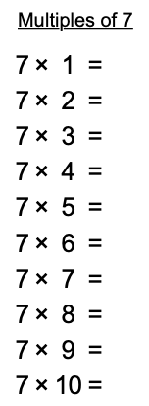
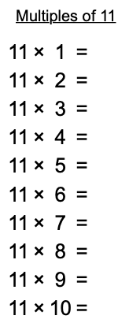
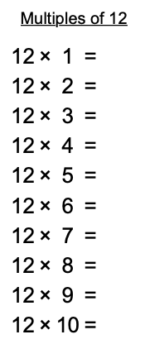
Year 8 DO NOW Week 4
Year 8 Skills: Friday [Times tables]

Slide 59
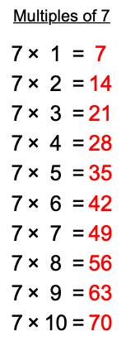
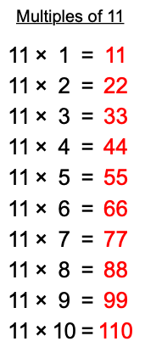
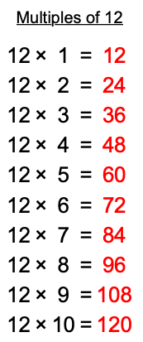
Year 8 DO NOW Week 4
Year 8 Skills: Friday [Times tables]

Slide 60
Fractions
To be able to add and subtract fractions with the same denominator
To be able to add and subtract fractions with different denominators
Key words
Denominator, Numerator, Equivalent

Slide 61
Fractions
$$\frac{2}{4} + \frac{1}{8}$$
$$\frac{2}{4} − \frac{1}{8}$$

Slide 62
Fractions

Slide 63
Fractions

Slide 64
Fractions
Progress Pit stop
Solve the following:
$\frac{1}{5}+\frac{2}{10}$
$\frac{6}{7}−\frac{1}{3}$
.
I don’t understand
I nearly understand
I fully understand

Slide 65
Fractions
$$\frac{2}{4} + \frac{1}{6}$$
$$\frac{3}{4} − \frac{1}{9}$$

Slide 66
Fractions
My Question

Slide 67
Problem Solving
Fractions

Slide 68
Fractions
Problem Solving

Slide 69
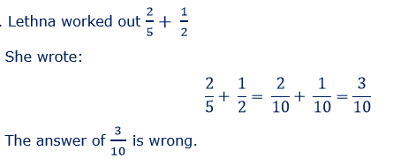
Fractions
Purple Problems

Slide 70
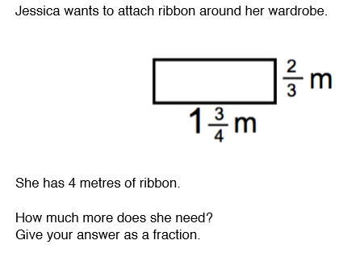
Fractions
Purple Problems

Slide 71
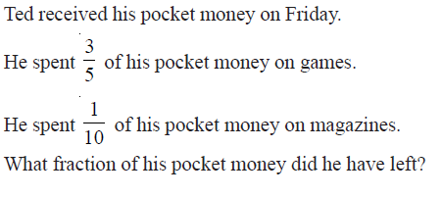
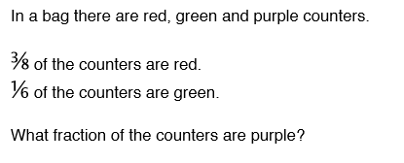
Fractions
Purple Problems

Slide 72
Fractions
Purple Problems
Henry walks ⁵/₁₂ km towards his friend Paul’s house.
The actual distance is ⁵/₈ km.
How far does he have to walk to finish the journey?

