Slide 1
Remote Learning Week 5

Slide 2
Read it:
Conflict
Define it:
(verb) to come into collision or disagreement; be contradictory, at variance, or in opposition; clash.
Deconstruct it:
From Latin conflīctus (a striking together) equivalent to conflīg(ere) (to strike together, contend)
Example:
In all of Shakespeare’s plays there are conflicts between groups of characters / families.
Digging Deeper:
It can also mean to fight or contend; do battle.
Link it:
combat, clash, competition, strife, struggle, battle, rivalry
Notes:
Q. What other words do you know begin with this?
Q. Can it be used in another way?
Q. What antonyms or synonyms do you know for this?
Q. How does it fit into what we have been learning?
Q. What action could we use to help us remember this?
Q. Can you think of a different subject where you
might use this word? Would it have the same
meaning there?

Slide 3
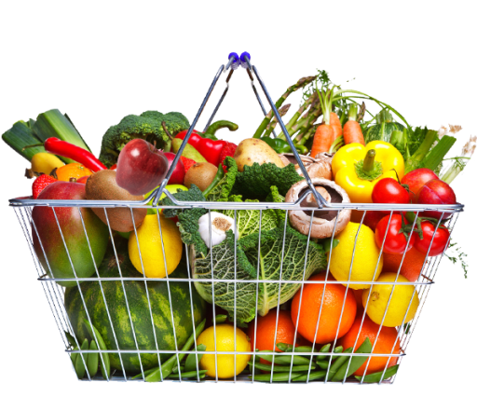
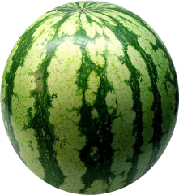
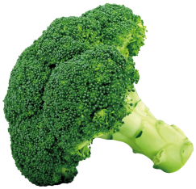
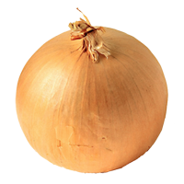
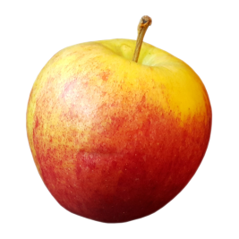
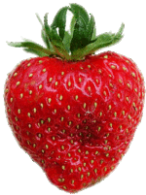
Do Now
English 5-a-day
1
5 minutes!
Define the noun conflict.
2
What does Romeo find out from the Nurse after Juliet goes to see her mother?
3
What does the chorus do in this prologue?
4
Is ‘began’ a regular or irregular verb?
STOP
5
What is a synonym for ‘brawl’?

Slide 4
Recall the prologue.
What did you learn in the prologue?
Can you remember any key quotations from the prologue?
What are the meanings of these quotations?
How does the prologue link to the actions in Act One?

Slide 5
Act 1 Recap:
Write down all you can remember about the plot in Act 1 in chronological order.
What quotations can you recall? How do they add meaning to the plot?

Slide 6
Act 1 Recap:
Write down all of the characters that you met in Act 1.
Recall/ find two quotes (for each character) which best help to describe the character and their intentions.

Slide 7
Do Now
English 5-a-day
1
5 minutes!
Use the noun conflict in a sentence.
2
What does Romeo do in order to avoid his friends?
3
What do Benvolio and Mercuito think Romeo is doing?
4
Choose the correct word affect/effect:
The ………….. of the conflict is devastating.
STOP
5
Select the correct homophone: Where/We’re/Were/Wear
_________ is Verona?

Slide 8
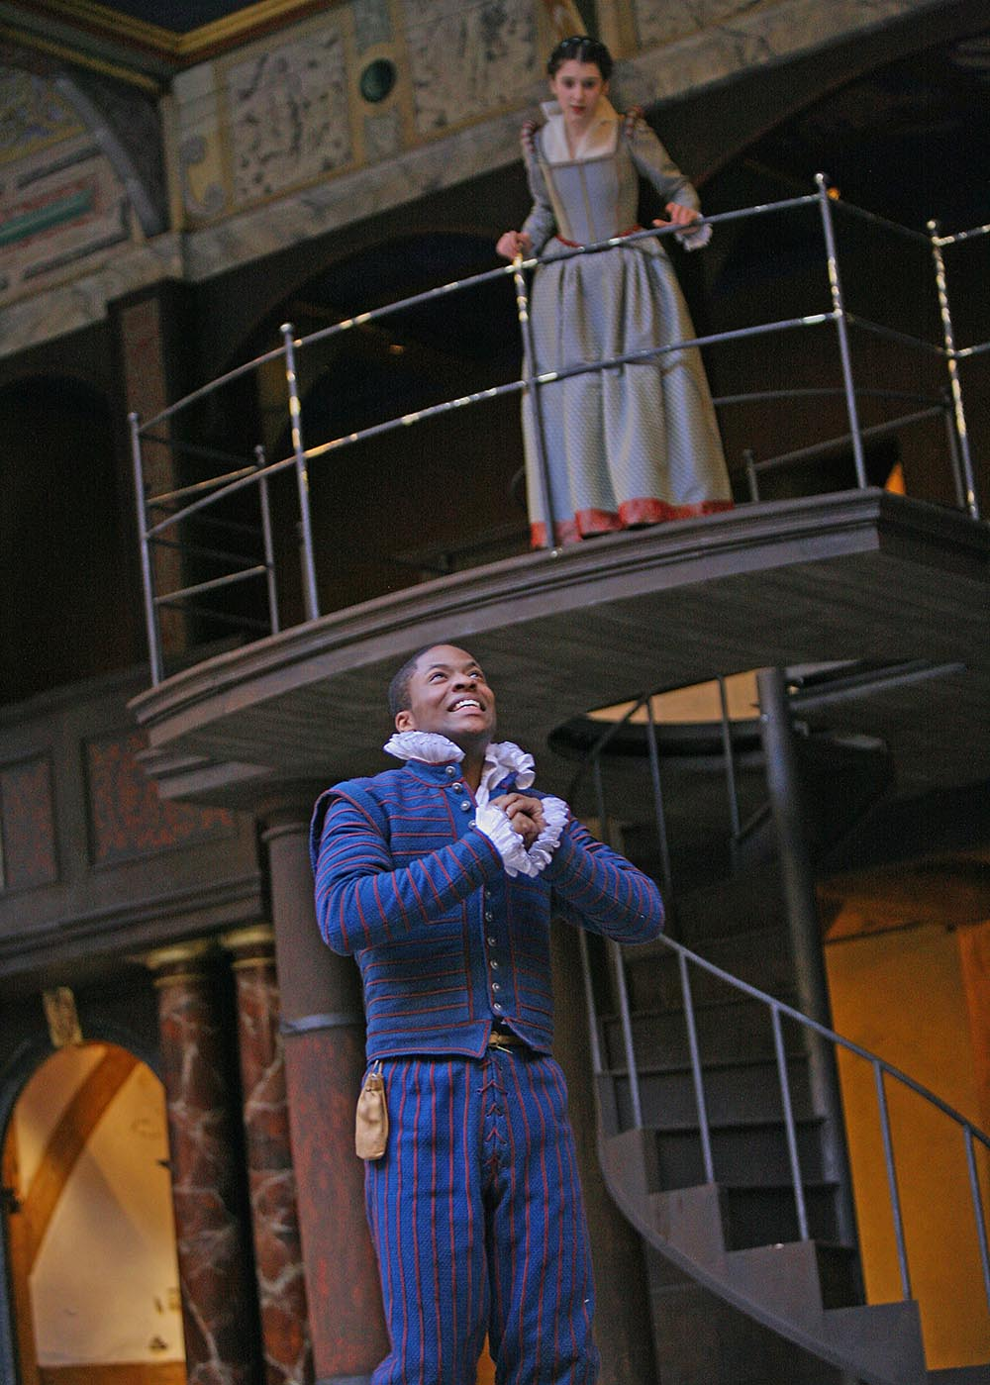
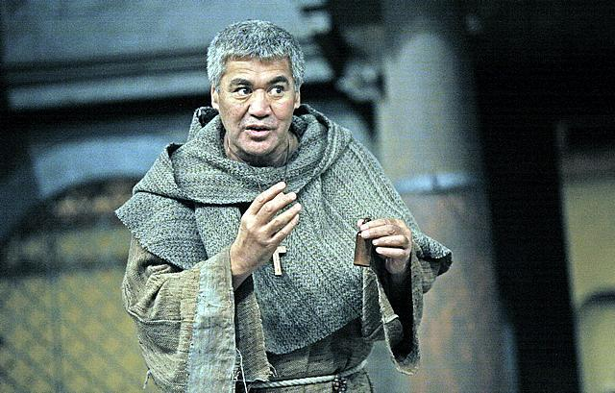
Act 2
Love?
Notes:
Does this need a more year 9 friendly title?

Slide 9
LSQ:
List two types of love you have witnessed in the play, so far?
Name a character who falls in love easily.
Name a character who doesn’t think seriously about love.
Name a fiery character.
Who is the peacemaker within the play, so far?

Slide 10
Act 2: Prologue
Now old desire doth in his death-bed lie,
And young affection gapes to be his heir;
That fair for which love groan'd for and would die,
With tender Juliet match'd, is now not fair.
Now Romeo is beloved and loves again,
Alike betwitched by the charm of looks,
But to his foe supposed he must complain,
And she steal love's sweet bait from fearful hooks:
Being held a foe, he may not have access
To breathe such vows as lovers use to swear;
And she as much in love, her means much less
To meet her new-beloved any where:
But passion lends them power, time means, to meet
Tempering extremities with extreme sweet.
What do we learn from the Prologue to Act 2?
What does it tell us about Juliet in line 4?
What does it tell about Romeo in lines 5-6?
What does it tell us about their love in lines 7-10?

Slide 11
Do Now
English 5-a-day
1
5 minutes!
What is the etymology of the noun conflict?
2
What does Romeo compare Juliet to?
3
What is Juliet’s enemy?
4
Choose the correct word your/you’re:
____ father will not be please, Juliet.
STOP
5
When and why is an adjective used?

Slide 12
Key word definitions:
Find the definitions for the words below:
Soliloquy
Envious
Grief
Discourse
Fairest
Entreat
Spheres
Using your understanding of this key vocabulary, read through and annotate Act 2 Scene 1.

Slide 13
Act 2 Scene 1: the balcony scene
We will look closely at this soliloquy in our Act 2 Booklet.
Benvolio and Mercutio are looking for Romeo after the masked ball. He has climbed the orchard wall to look up at Juliet’s balcony. This is linked with courtly love.
But, soft! what light through yonder window breaks? It is the east, and Juliet is the sun. Arise, fair sun, and kill the envious moon, Who is already sick and pale with grief, That thou her maid art far more fair than she: Be not her maid, since she is envious; Her vestal livery is but sick and green And none but fools do wear it; cast it off. It is my lady, O, it is my love! O, that she knew she were! She speaks yet she says nothing: what of that?
Her eye discourses; I will answer it. I am too bold, 'tis not to me she speaks:
Two of the fairest stars in all the heaven, Having some business, do entreat her eyes To twinkle in their spheres till they return. What if her eyes were there, they in her head? The brightness of her cheek would shame those stars, As daylight doth a lamp; her eyes in heaven Would through the airy region stream so bright That birds would sing and think it were not night. See, how she leans her cheek upon her hand! O, that I were a glove upon that hand, That I might touch that cheek!

Slide 14
Key word definitions:
Find the definitions for the words below:
Contract
Unadvised
Cease
Ripening
Beauteous
Repose
Using your understanding of this key vocabulary, read through and annotate Act 2 Scene 1.

Slide 15
Act 2 Scene 1: the balcony scene
This scene focuses on the dialogue between Romeo and Juliet. They profess their love for one another using celestial imagery. Juliet persuades Romeo to agree to marry her.
Questions
Why does Juliet refuse to give in to Romeo’s request that he climb onto her balcony?
Why does she make him wait until the morning, to develop their relationship further?
Why does she make him agree to marriage?
Well, do not swear: although I joy in thee, I have no joy of this contract to-night: It is too rash, too unadvised, too sudden; Too like the lightning, which doth cease to be Ere one can say 'It lightens.' Sweet, good night! This bud of love, by summer's ripening breath, May prove a beauteous flower when next we meet. Good night, good night! as sweet repose and rest Come to thy heart as that within my breast!
Later in the scene
‘If that bent of love be honorable, thy purpose marriage, send me word tomorrow.’

Slide 16
Do Now
English 5-a-day
1
5 minutes!
Write down a word you associate with the noun conflict, or a synonym.
2
In the balcony scene, why doesn’t Romeo reveal himself?
3
Why doesn’t Juliet want Romeo to swear by the moon?
4
Write down the adjective(s) in this sentence:
Romeo is a romantic, naïve, young man.
STOP
5
What is a collective noun?

Slide 17
Act 2 Scene 2: Who is Friar Laurence?
In this scene we meet an important new character, Friar Laurence; a religious man and Romeo’s confidant and counsellor. His character is essential to the plot; he is able to marry Romeo and Juliet to each other, he is knowledgeable about herbs and gives Juliet a herbal potion which mimics death.
We will explore this short speech in our booklets.
Benedicite! What early tongue so sweet saluteth me? Young son, it argues a distemper'd head So soon to bid good morrow to thy bed: Care keeps his watch in every old man's eye, And where care lodges, sleep will never lie; But where unbruised youth with unstuff'd brain Doth couch his limbs, there golden sleep doth reign: Therefore thy earliness doth me assure Thou art up-roused by some distemperature; Or if not so, then here I hit it right, Our Romeo hath not been in bed to-night.
What does this speech reveal about Friar Laurence?

Slide 18
Act 2 Scene 2: Who is Friar Laurence?
Shakespeare has created Friar Laurence as a, mostly, wise voice in the play.
Look at the following which are quotations from his speeches.
Why are these quotations important?
Holy Saint Francis, what a change is here!
Is Rosaline, that thou didst love so dear,
so soon forsaken? Young men’s love, then lies
Not truly in their hearts but their eyes
***
For doting not for loving , pupil mine
***
Young waverer
***
Wisely and slow they stumble that run fast.
What do these quotations reveal about Friar Laurence?

Slide 19
Do Now
English 5-a-day
1
5 minutes!
How is the noun conflict linked with ‘Romeo and Juliet’?
2
What is Juliet concerned about in the balcony scene?
3
What do Romeo and Juliet plan for the next day?
4
What is a synonym for ‘unhappy’?
STOP
5
What is ‘prefer’ in the past tense?

Slide 20
Knowledge Recall:
List all that you can recall about Friar Lawrence.
How many quotes can you remember which relate to Friar Lawrence?
What do these quotes reveal about the Friar?

Slide 21
Act 2 Scene 6: Who is Friar Laurence?
In this scene, Romeo and Juliet meet Friar Laurence for the marriage ceremony.
Here, the Friar once again dispenses his wisdom.
What observation does he make?
Friar Laurence
These violent delights have violent ends And in their triumph die, like fire and powder, Which as they kiss consume: the sweetest honey Is loathsome in his own deliciousness And in the taste confounds the appetite: Therefore love moderately; long love doth so; Too swift arrives as tardy as too slow.
Summarise this speech in your own words- what does it mean?
What are the key words in this speech? What effect do they have on the audience?
How does this speech link to the themes of the play and the Prologue to the play?

