Slide 1
Remote Learning Week 6

Slide 2
Read it:
Chemical
Define it:
(noun) a substance produced by or used in a chemical process.
Deconstruct it:
From Greek chemic (“alchemy”) +‎ -al (“related to”)
Example:
The subject Chemistry in school is based around studying chemicals, acids and other liquids.
Digging Deeper:
It can also mean of, used in, produced by, or concerned with chemistry or chemicals: a chemical formula; chemical agents.
Link it:
Synthetic, actinic, Alchemical, enzymatic, synthesized,
synthetical
Notes:
Q. What other words do you know begin with this?
Q. Can it be used in another way?
Q. What antonyms or synonyms do you know for this?
Q. How does it fit into what we have been learning?
Q. What action could we use to help us remember this?
Q. Can you think of a different subject where you
might use this word? Would it have the same
meaning there?

Slide 3
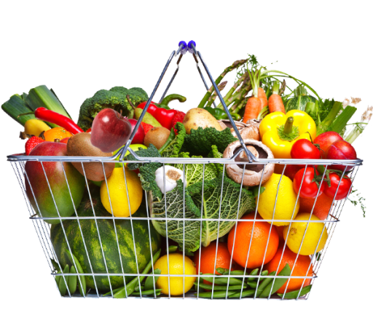
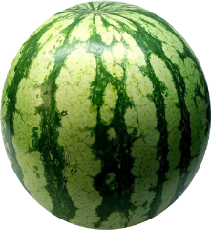
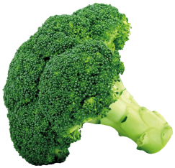
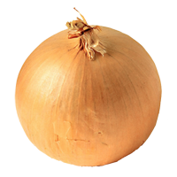
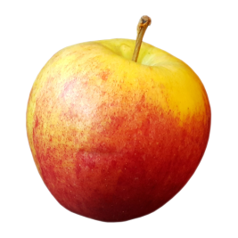
Do Now
English 5-a-day
1
5 minutes!
Define the noun chemical
2
a) Who does Romeo visit to ask for help?
3
b) What is he doing when Romeo visits?
4
Where does the apostrophe go?
The Friars advice is neutral.
STOP
5
What is ‘write’ in the past tense?

Slide 4
Act 2 Scene 3: Who is the Nurse ?
Shakespeare has created the Nurse as a confidante for Juliet, a maternal figure who loves Juliet and is close to her; without the Nurse, the marriage would not take place.
We meet the Nurse first in Act 1 Scene 3, then Act 2 Scene 3 and 4, Act 3 Scene 2, 3 and 5, Act 4 Scene 3, 4.
She is present at key turning points of the play.
Act 1 Scene 3 | Recalls Juliet’s childhood
Act 2 Scene 1 | Calls Juliet away from the balcony
Act 2 Scene 3 | Meets Romeo to tell him of the marriage arrangements
Act 2 Scene 5 | Returns to Juliet with Romeo’s response.
Act 3 Scene 2 | Brings Juliet the news of Tybalt’s death, murderer by Romeo
Act 3 Scene 3 | Visits the Friar to tell Romeo to go to Juliet.
Act 3 Scene 5 | Calls Juliet away from her night with Romeo to speak to her parents about marriage to Paris. Tells Juliet to forget about Romeo and marry Paris.
Act 4 Scene 3 | Juliet tells the Nurse and her mother to leave her to sleep, the night she takes the potion.
Act 4 Scene 4 | Discovers Juliet, when she appears dead.

Slide 5
Key word definitions:
Find the definitions for the words below:
Warrant
Brow
Parlous
Bitterly
Using your understanding of this key vocabulary, read through and annotate Act 1 Scene 2.

Slide 6
Act 2 Scene 3: Who is the Nurse ?
The Nurse is able to be inside (private) and outside (public) the Capulet house. As an elite, unmarried girl, Juliet is restricted in her movements, therefore the Nurse has to be her contact with the outside, public world.
The Nurse talks about breastfeeding and sex, and would be Juliet’s guide in these matters. As a lower-class character, the Nurse is bawdy and rude at times!
How is the Nurse first presented?
Yes, madam: yet I cannot choose but laugh, To think it should leave crying and say 'Ay.' And yet, I warrant, it had upon its brow A bump as big as a young cockerel's stone; A parlous knock; and it cried bitterly: 'Yea,' quoth my husband,'fall'st upon thy face? Thou wilt fall backward when thou comest to age; Wilt thou not, Jule?' it stinted and said 'Ay.’
***
Peace, I have done. God mark thee to his grace! Thou wast the prettiest babe that e'er I nursed: An I might live to see thee married once, I have my wish.
We will look closely at this in our Act 2 Booklet.

Slide 7
Do Now
English 5-a-day
1
5 minutes!
Use the noun chemical in a sentence.
2
In Act 2 Scene 3, what does Friar Laurence say about the earth?
3
What are some of the powers of herbs?
4
Complete the sentence with the correct collective noun:
A _____ of men.
STOP
5
Select one determiner to add to the sentence:
Sometimes it is hard to be …. good girl. (a/the)

Slide 8
Act 2 Scene 4: Who is the Nurse ?
The Nurse bring news of Romeo’s response to the marriage arrangements. She teases Juliet by withholding his answer and pretending to be tired.
Juliet is impatient to hear what Romeo has said.
Juliet
How art thou out of breath, when thou hast breath To say to me that thou art out of breath? The excuse that thou dost make in this delay Is longer than the tale thou dost excuse. Is thy news good, or bad? answer to that; Say either, and I'll stay the circumstance: Let me be satisfied, is't good or bad?
Nurse
Well, you have made a simple choice; you know not how to choose a man: Romeo! no, not he; though his face be better than any man's, yet his leg excels all men's; and for a hand, and a foot, and a body, though they be not to be talked on, yet they are past compare: he is not the flower of courtesy, but, I'll warrant him, as gentle as a lamb. Go thy ways, wench; serve God. What, have you dined at home?

Slide 9
How does Shakespeare present the nurse at the beginning of the play?
Shakespeare presents the nurse as…
This is displayed through…
The use of the (insert writer’s technique)
The word ‘…’ implies
This could also mean…
An Elizabethan audience would have thought the nurse was …

Slide 10
Do Now
English 5-a-day
1
5 minutes!
What is the etymology of the noun chemical?
2
a) What does Romeo ask Friar Laurence to do?
3
b) What is the Friar’s initial response to Romeo’s request and why does he change his mind?
4
Punctuate the following sentence:
Friar Lawrence whom Romeo turns to for guidance is close to Romeo.
STOP
5
Where should the apostrophe go?
Friar Lawrences decision has severe consequences.

Slide 11
How does Shakespeare present love in Romeo and Juliet?
Look back in your booklets and consider all of examples that Shakespeare has included of love.
Shakespeare presents love as…
He also presents love as…

Slide 12
How does Shakespeare present love in Romeo and Juliet?
Shakespeare presents love as…
This is displayed through…
The (insert technique) conveys…
The word … implies
He also presents love as…

Slide 13
Do Now
English 5-a-day
1
Write down a word you associate with the noun chemical, or a synonym.
5 minutes!
2
In Act 2 Scene 4, what two things did Benvolio discover at Montague’s home?
3
What does Mercutio say about Tybalt?
4
Where does the semi-colon go?
Tybalt is a Capulet he loathes the Montagues.
STOP
5
Define the use of a colon.

Slide 14
What is the significance of the Friar at the beginning of the play?
Look back through your booklets and consider how Friar Lawrence has been presented in the play so far.

Slide 15
How is the Friar presented at the beginning of the play?
The Friar is presented as…
This is conveyed through…
The (insert technique) demonstrates that…
The use of the word …
An Elizabethan audience would have considered the Friar to be…

Slide 16
Do Now
English 5-a-day
1
5 minutes!
How is the noun chemical linked with ‘Romeo and Juliet’?
2
In Act 2 Scene 4, what does Romeo tell the Nurse?
3
In Act 2 Scene 5, what is Juliet’s state of mind as she waits for the Nurse?
4
Is the colon used correctly in this sentence?
My life: had changed for ever. I was going to marry the boy of my dreams.
STOP
5
What is a synonym for ‘rage’?

Slide 17
The play so far… Watch play up to the end of Act 2 and answer the questions on the following slide.

Slide 18
What is the significance of Act 2?
Who do we meet in Act 2?
What happens in Act 2?
Why does Act 2 focus on these characters and these events?
What will we, the audience, expect from the next act, Act 3?
How does Act 2 link to the rest of the play?

