Slide 1
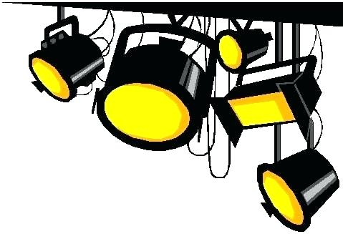
Drama Knowledge Organiser
Roles within the theatre
Conventions and Techniques
Actor or Performer | The people that perform in the play or performance.
Director | The Director has the overall artistic view for the play, instructs the actors and brings everything together.
Technician | The Technician operates and maintains the lights, sound or special effects during the performance.
Designer | The person who designs and creates the set, costume or lights.
Stage Manager | The Stage Manager manages rehearsals, actors, technicians, props and costume fittings, and liaise with front-of-house staff. They are in charge of the production after the rehearsals.
Theatre Manager | The Theatre Manager looks after everything “Front of House”, Tickets Sales, Promotion and Staff.
Playwright | The person who writes the script.
Monologue | A long speech by one actor.
Duologue | A scene between two actors.
Narration | The act of telling a story. This can be done by on actor “The Narrator” or by the whole cast.
Tableau or Freeze Frame | A motionless image depicting a story or scene.
Aside | When an actor speaks directly to the audience.
Improvisation | A performance which is made up spontaneously (on the spot).
Hot Seating | Questions are asked to someone sitting in the 'hot-seat' who answers in character.
Split Scene | Two or more scenes which are performed on stage at the same time.
Montage | A sequence of small scenes or still images, often used to chow the passage of time.
Key Words
The Space
The area in which you perform.
Rehearsal
A practice or trial performance of a play
The Script
Written by the Playwright, which tells the actors what to say and do.
(Not all performances have scripts)
The Fourth Wall
The invisible imagined wall which separates the audience from the action.
Stage Directions
Stage Directions tell the actors what to do and are often written in Italics.

Slide 2
Staging
There are different ways you can chose to stage your piece, you must consider how it will affect your audience experience and the overall atmosphere of the piece.
“Rake” Staging
When the floor of the stage is sloped toward the audience.
Proscenium Arch
Immersive Theatre
A proscenium is the metaphorical vertical plane of space separating the audience usually surrounded on the top and sides by a physical proscenium arch.
Immersive theatre breaks the fourth wall and brings the audience into the action and the set. The audience are active participants.

