Slide 1
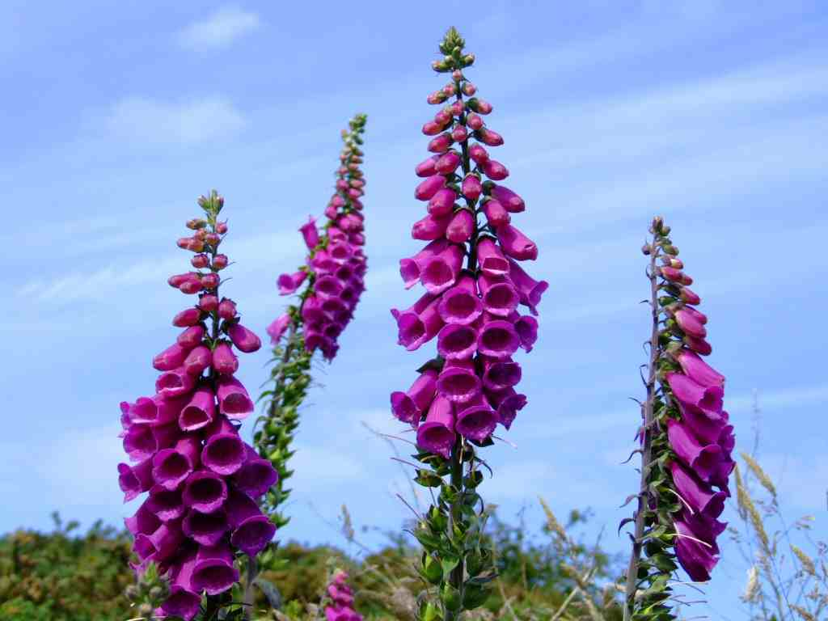
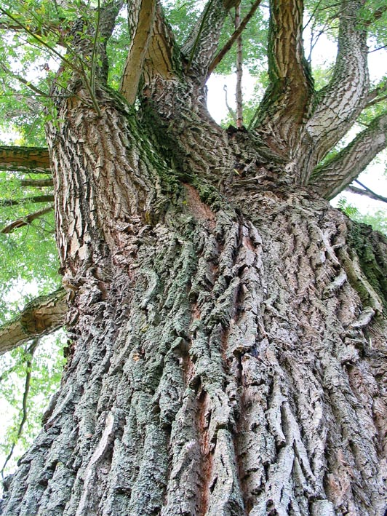
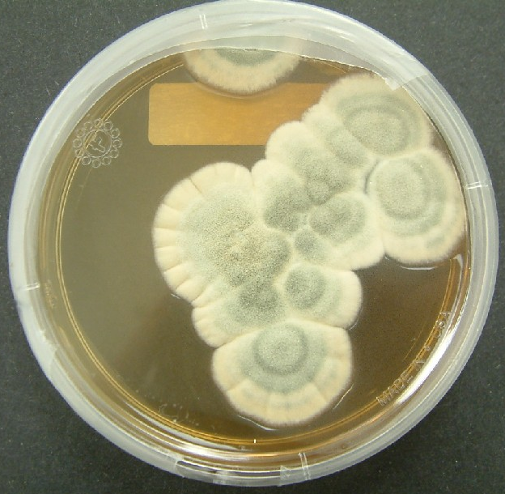
What do you think the link between all of these photos might be?

Slide 2
Bark from the white willow tree - aspirin which is a painkiller
Foxgloves – Digitalis which affects the heart rate.
They are all sources of chemicals that have been/are used for medicines
Penicillium mould – Can you guess?

Slide 3
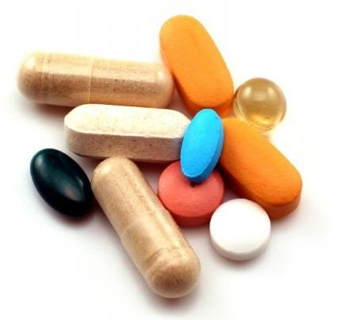
Walt: Know where new medicines and drugs come from
WILF:
GW: You can identify where many medicines come from and the characteristics that make a substance suitable as a medicine.
BI: You can describe the main steps that drug companies take to test new medicines. You can consider and discuss some of the issues that have arisen during testing of new medicines.
EW: You can describe how drugs trials are made as valid as possible.
Where do you think new medicines might come from? Write down any ideas you have.

Slide 4
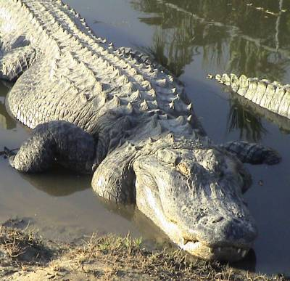
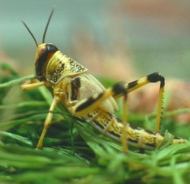
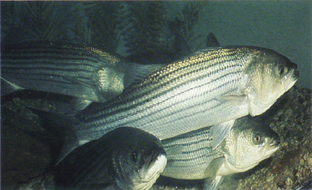
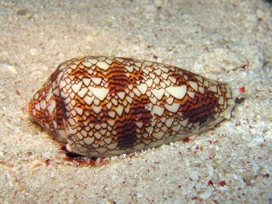
Rainforest may hold key to new drugs
Alligator Blood May Lead to Powerful New Antibiotics
Cockroach Brains May Hold New Antibiotics?
Scientists believe British plants are an untapped source of new drugs which could treat a host of medical conditions.
New Antibiotic Found in Fish Cells
Toxic Snail Venoms Yielding New Painkillers, Drugs
Daffodil drug's Alzheimer's help

Slide 5
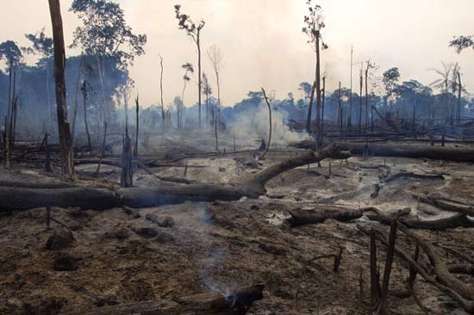
Why would this be a disaster for drug companies?
Only about 5% of all plants in the Amazon rainforest have been properly tested as a source of new drugs.

Slide 6
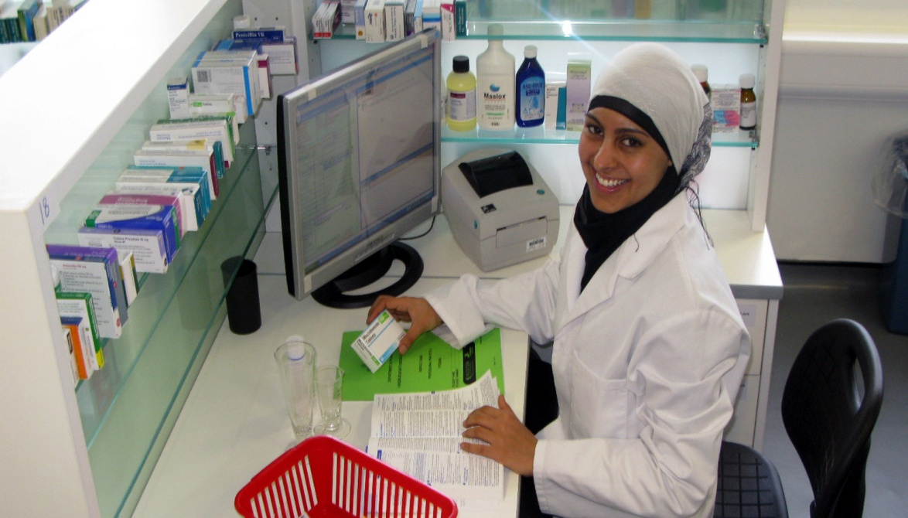
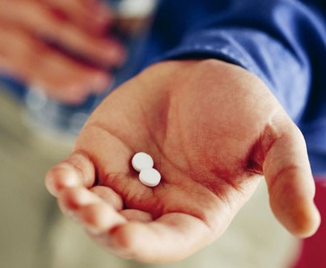
What happens next?
When potential new medicines have been identified, what happens next?
Imagine you were asked to take part in the testing of a new drug – what would you want to ask before you agreed to take part?

Slide 7
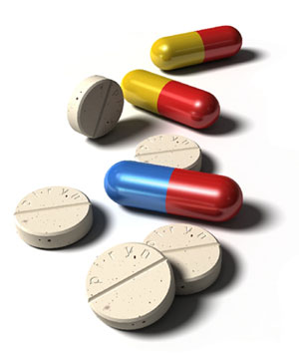
What are the characteristics of a good medicinal drug?
The drug must prevent or cure the disease it is designed to treat – this is the efficacy of the drug.
The drug must not be toxic or have unacceptable side effects.
Safe
Effective
Characteristics of a good medicinal drug
Safely taken into and removed by the body
Stable
It must reach its target and then be able to be broken down by the body once it has done its job.
The drug must not change when it is not in use or is being stored for a period of time.

Slide 8
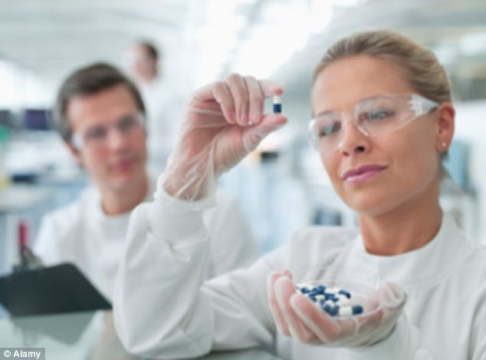
Stages of the drug testing process
You have been given some information about the stages a drug goes through during its testing process.
Work together as a group to see if you can sort them into the correct order.
WILF:
BI: You can describe the main steps that drug companies take to test new medicines.

Slide 9
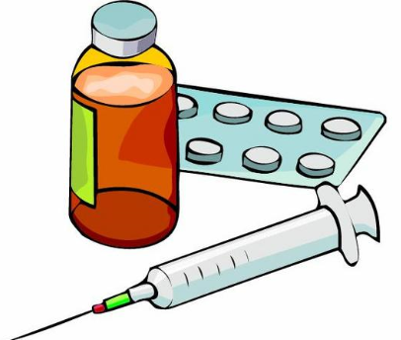
Pre clinical trial (doesn’t involve any humans) | Clinical trials
Tests on healthy volunteers
Tests on animals
Tests on larger groups of patients
Tests on small groups of patients
Tests on cell and tissue samples

Slide 10
 | Blind trial | Double-Blind trial
Does the patient know whether they are getting the drug or the placebo?
Does the doctor know whether they are getting the drug or the placebo?

Slide 11
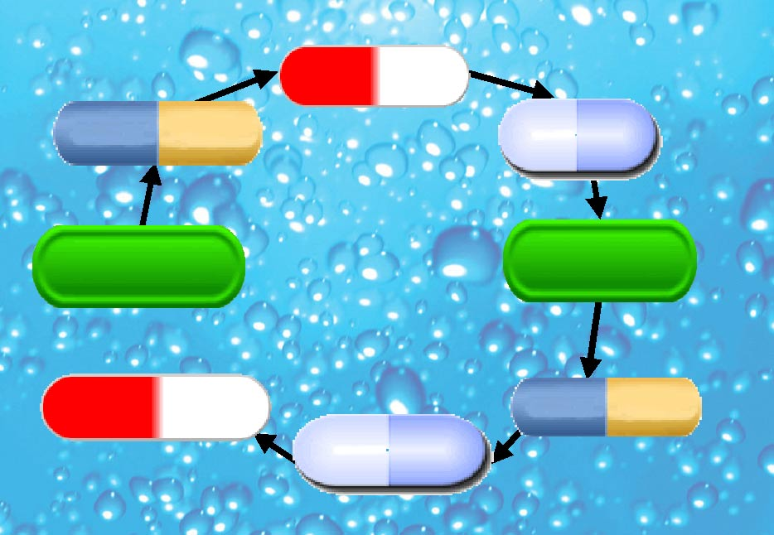
Synthetic chemicals?
Traditional remedies?
First tests in laboratory
Drug Development and
Testing
Which diseases to treat?
Animal testing
Phase III: Final tests and licensing
Phase I: Testing on volunteers!
Phase II: Testing on patients

Slide 12
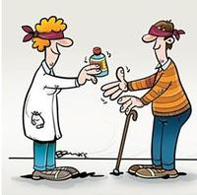
Valid drugs trials
If a drugs company has created a new drug that they think works, they might interpret the results to fit with their expectations because they want it to work well. This is called BIAS.
How do companies need to make sure they don’t introduce bias into the results?
In human trials, scientists often use double-blind trials to see how effective a new medicine is. Some patients are given the drug and others a placebo, neither the doctor or the patient knows who has received the drug being tested.

Slide 13
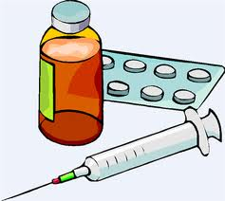
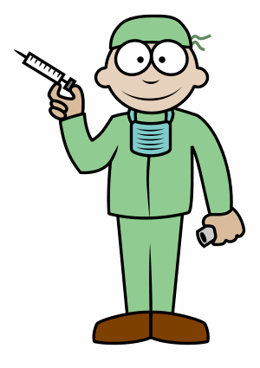
Drugs trials
In clinical trials doctors use a placebo, this is something that looks similar to the drug being tested. It is supposed to stop the volunteer from knowing if they’ve been given the trial drug or not.
The placebo often contains a drug that is already used to treat the disease, this ensures that a patient is not deprived of treatment by taking part in a trial.

Slide 14
Placebo drug Actual drug being tested
The placebo being given to the patient needs to resemble the actual drug being tested as closely as possible except for any active ingredients.

Slide 15
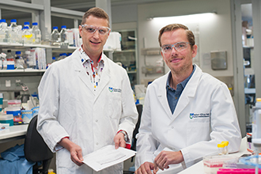
What next?
Our results are very promising and we are ready to tell the world!
Hang on... We can’t just publish them straight away....
What do you think needs to happen BEFORE the results of the trial are published?

Slide 16
Before the results of the trial are published, they must undergo PEER REVIEW, by other medical professionals. Why?
Peer review is important as it allows the results to be checked and prevents companies making false claims about medicines.

Slide 17
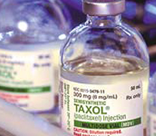
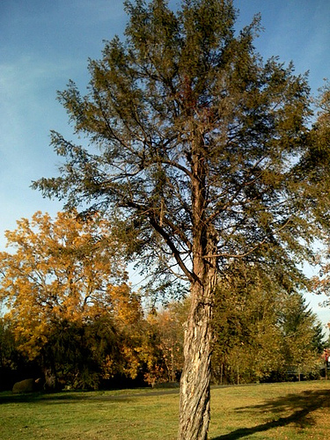
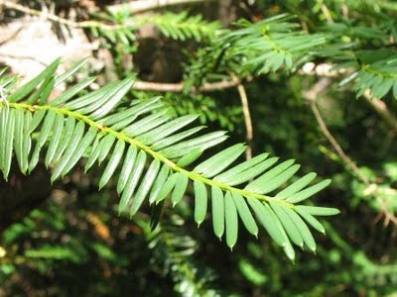
A successful example...
In 1971 a drugs company successfully extracted a chemical from the Pacific yew tree, which is used for treating cancer. The drug is marketed as ‘Taxol’

Slide 18
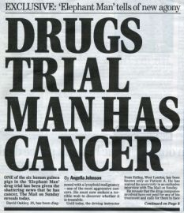
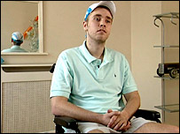
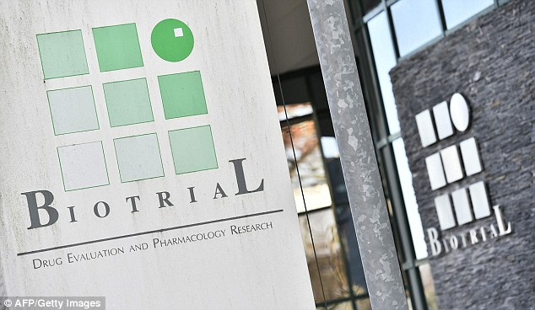
Can things go wrong?
Click each photograph for a video clip
Discuss with other members of your group – is it worth it?

Slide 19
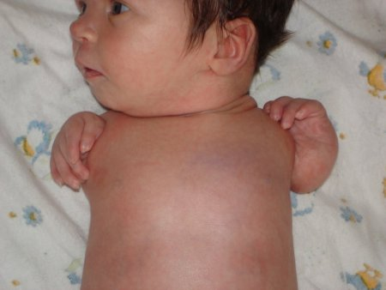
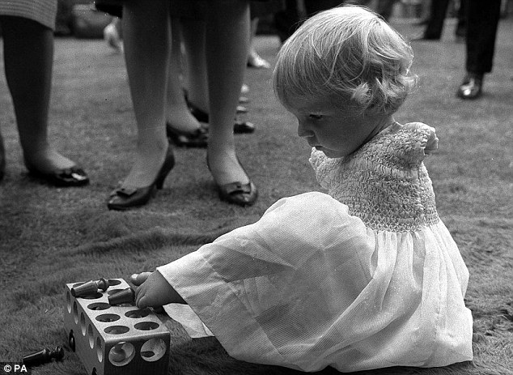
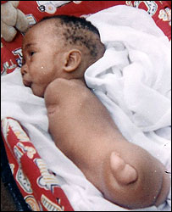
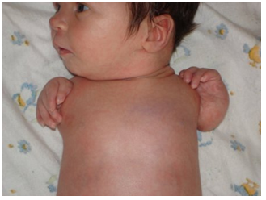
Why are drugs tested so thoroughly?
Do you know what might have happened in these images?

Slide 20
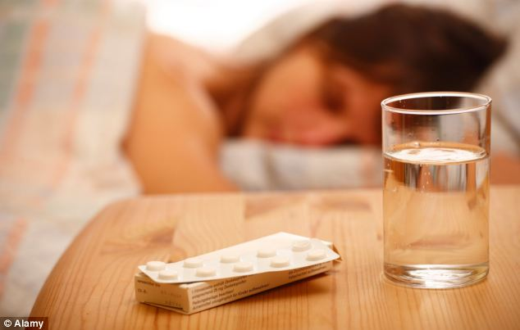
Thalidomide was developed in Germany in the 1950s as a sleeping pill.

Slide 21
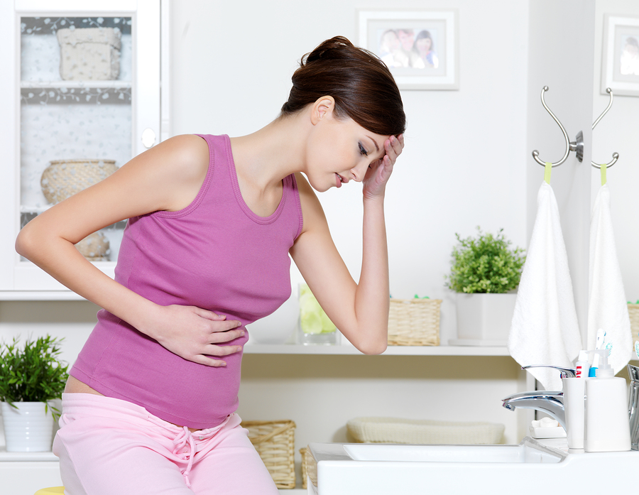
It was discovered that it was also useful at relieving symptoms of morning sickness during pregnancy.

Slide 22
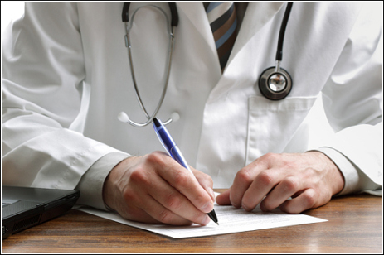
Doctors then began prescribing it to pregnant women.

Slide 23
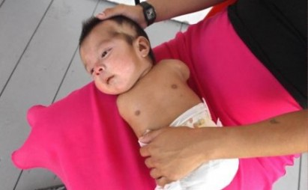
An Australian doctor began to notice a higher number of babies were being born with limb deformities

Slide 24
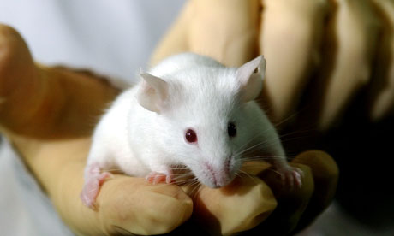
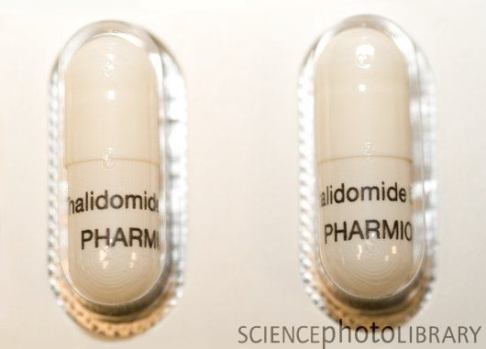
Why wasn’t this issue detected?
It hadn't been correctly tested – it did pass animal tests, but extensive testing was never carried out.

Slide 25
After this issue with Thalidomide, a law was passed in the 1968 Medicines Act, that stated ALL new drugs to be used for medicines must be trialed on animals (including pregnant ones)
Do you AGREE or DISAGREE with this?

Slide 26
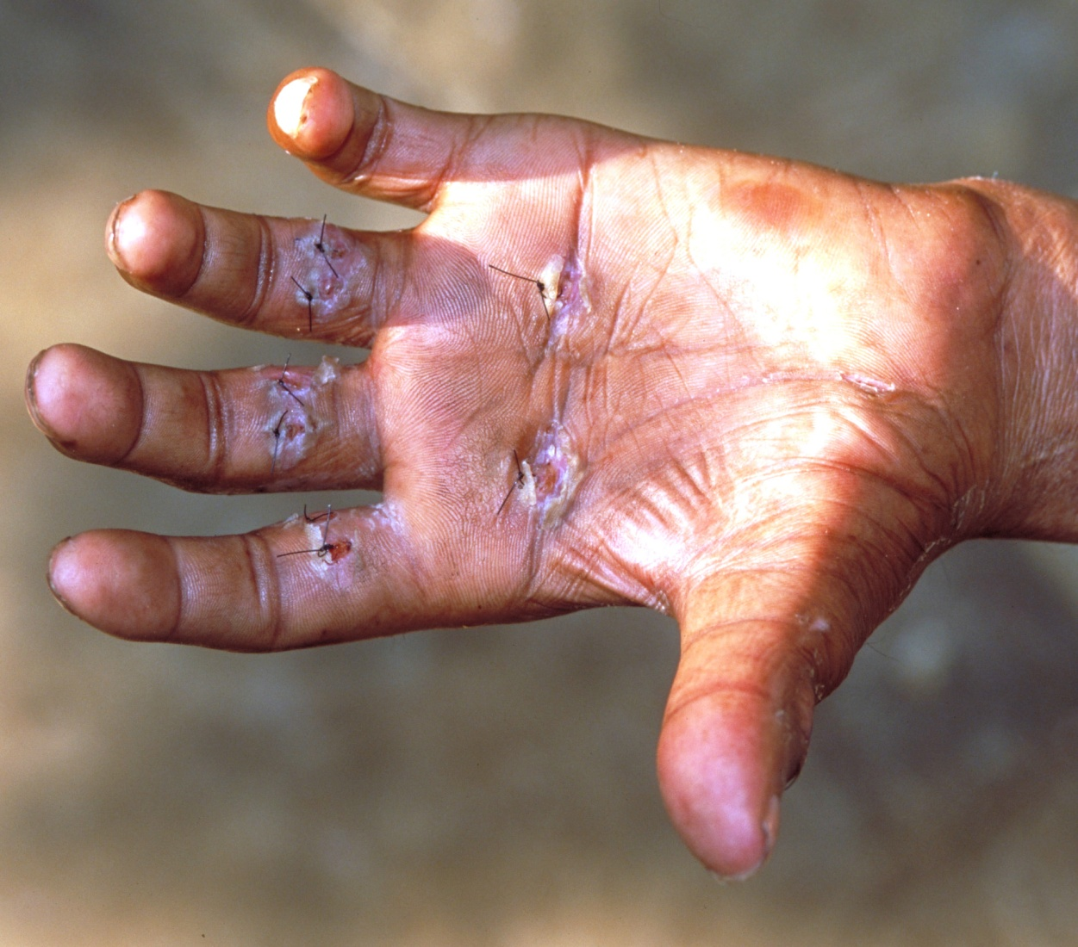
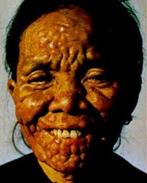
Leprosy is caused by a bacteria that slowly affects the nerve endings
Nowadays, Thalidomide is used to treat early Leprosy and symptoms of HIV and AIDs. (However it was recently banned as a treatment for leprosy as children were once again being born with limb deformities)

Slide 27
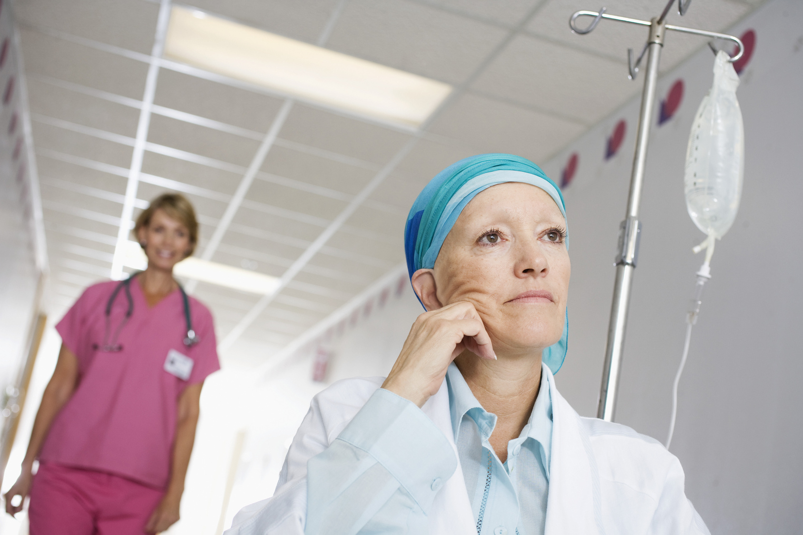
It is hoped that it could be used in future to treat various kinds of Cancers.

Slide 28
Questions
1) What type of drug was thalidomide originally developed as?
2) What were the problems in the way in which thalidomide was tested?
3) Why do you think that a new law was then passed in 1968 that all medical drugs need to be tested on animals?
4) What type of diseases is thalidomide CURRENTLY thought to be useful for treating?
5) Which diseases in the FUTURE do scientists hope to use thalidomide to treat?

