Slide 1


William Paley said if something as intricate as a …………………………………. Was designed then the world must be too.
What is the name of somebody who believes in a God?
What is the name of somebody who isn't sure if they believe in God?
Do now task
How much can you remember?
Notes:
Watch
Theist
agnostic

Slide 2
Read it:
Ethically
Define it:
Moral and correct behaviout
Deconstruct it:
Greek ethikos one's disposition, customs, manners, morals,"
Example:
It is ethically right that animals should have rights
WOW
Link it:
Moral, right, belief, ethics, just

Slide 3
Evil and suffering
Starter: list ways we see evil in our world happening.

Slide 4
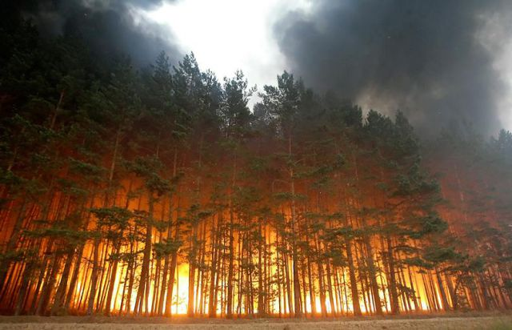
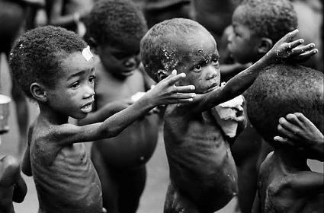
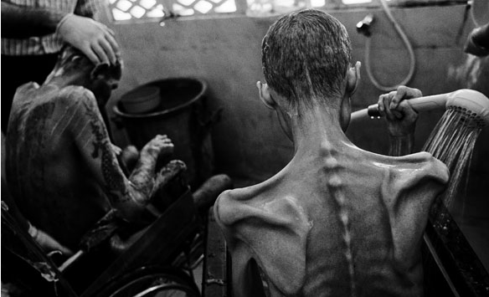
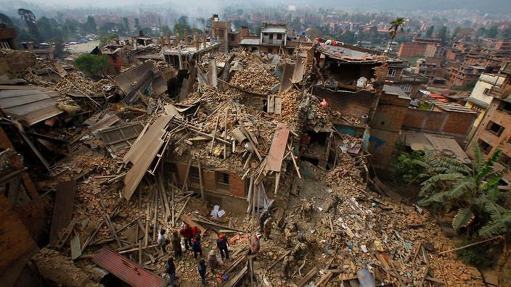
Does this prove God doesn’t exist?

Slide 5
What’s the problem?
Inconsistent Triad
Good grades
Enough sleep
A good social life
Can you have all three? Or does the presence of two make the other impossible?

Slide 6
Can you have all three? Or does the presence of two make the other impossible?
Evil Exists
God is all powerful
God is all good
Inconsistent Triad

Slide 7

God is…
Omniscient – God is all-knowing. God has infinite knowledge, he knows everything, even the future.
Omnipotent – God is all-powerful. God has unlimited power and can do anything.
Benevolent – God is all loving. God is perfectly good and all loving.
Just – God is completely fair and just, so that all will be judged fairly without discrimination.

Slide 8
So what’s the problem with Evil?
An omnipotent God should have the power to stop suffering and evil.
An omniscient God would know about and therefore want to stop suffering.
A benevolent God would care about suffering so would stop it.
But suffering and evil happen so maybe God isn’t these things…
Maybe God doesn’t exist!

Slide 9
How to solve the problem?
First we need to split evil into moral (caused by humans) and natural (caused by nature)

Slide 10

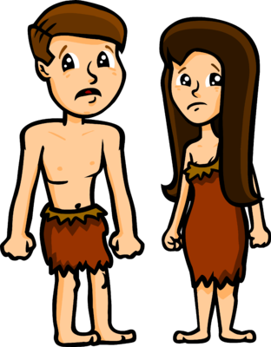
Responses to Moral Evil…
Some Christians believe that evil is a cause of humans and their free will. They believe that evil happens because humans are filled with greed, hatred and selfishness.
Many Christians believe that the devil or Satan is a cause of evil. This being tries to tempt humans in to disobeying God
HOWEVER
Task: Summarise these ideas into your own words.

Slide 11




Suffering caused by nature
Some possible responses…
Balance
Suffering is needed as a balance – to appreciate good, we have to be able to recognise evil/bad. It is impossible to have one without the other.
Punishment
Suffering is a punishment for wrong doing. Everyone does things wrong and so everyone might deserve to be punished.
Test of faith
Suffering is a test of faith in God. Human beings should view suffering as a test which they must try to get through. If they do, the reward from God will be great.
Education
Suffering is a form of education for our souls. By suffering, we go spiritually and also we learn to take responsibility and help others.

Slide 12
Question
‘God must not be omnipotent if he allows crime to happen’ to what extent do you agree with this statement? (8 mark)

Slide 13
Homework
Learn key words 1-8 on your knowledge organiser

