Slide 1
Do now task
How much can you remember?
What name is given to people who self harm but do so to remove an imperfection, like a spot or a jagged nail. Bonus mark for spelling
How can we support those with an easting disorder?
What does last weeks key word ‘anxiety’ mean?
Pencil cases out
Conduct cards in pencil cases
Coats and bags off
Notes:
1. Dematillomania

Slide 2
Read it:
Strategies
Define it:
a plan of action designed to achieve a long-term or overall aim.
Deconstruct it:
"general, commander of an army,“ linked to leader/ ideas/ rule.
Example:
We need to think about different coping strategies
Digging Deeper:
the art of planning and directing overall military operations and movements in a war or battle. Often contrasted with tactics.
Plan of action/plan/ policy/ Game plan
Link it:

Slide 3
What is a ‘Growth Mindset’ and how can having one
help us achieve and be successful?
Amy has just scored 60% on her maths test. She doesn’t think she can do much better and hates her maths lessons so she doesn’t put her all into the work. When’s she ever going to use Pythagoras anyway?
Jamie has just scored 55% on his maths test. He’d like to have done better, but has decided to try and apply himself and do his homework. He finds Pythagoras hard, but thinks about how useful the theorem could be to someone designing a house.
STARTER:
Challenge: Who do you think is going to do best in their next maths test?
More challenging: Why you think this? Write the answer in your books.
Mega challenge: Explain what you think the term ‘Growth Mindset’ might mean.

Slide 4
KEY WORD:
Growth Mindset – The idea that your mind will not always be the same and can be shaped to achieve what you would like it to, through hard work, dedication and resilience.
Discussion point:
Who are you more like, Amy or Jamie? Why is this?
LOs:
Challenge:
Identify statements that describe either a Fixed or a Growth Mindset.
More challenging:
Describe the attributes of a Fixed or Growth Mindset and how we can apply those of a Growth Mindset to our own lives.
Mega challenge:
Explain why a Growth Mindset can help us succeed and develop our skills and personal qualities.

Slide 5
Task one-
As you watch the clip, choose either red, green or
amber challenge questions to answer.
https://www.youtube.com/watch?v=75GFzikmRY0
Some people have a Growth Mindset, whilst others have a …………………………..
Who believes you ARE in control of your abilities?
What kind of people in which jobs are helped by having a Growth Mindset?
What do people with a Fixed Mindset think about effort?
What do people with a Fixed Mindset think about skills and abilities?
Why are people with a Growth Mindset more likely to succeed?
Why is a having a Growth Mindset so important?
What do people with a Fixed Mindset tend to focus on and what exactly does this mean for them?
Why does ‘appreciating feedback’ help us?

Slide 6
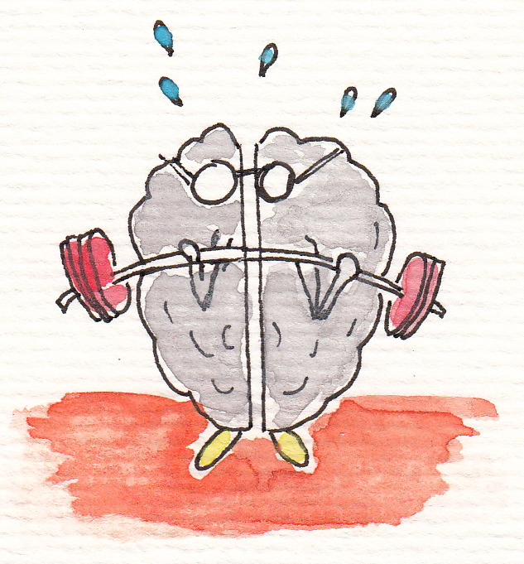
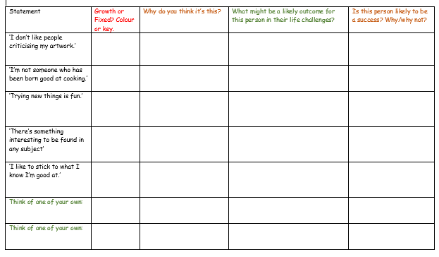
Task 2: Growth Mindset or Fixed Mindset?
Challenge:
Identify statements that describe either a Fixed or a Growth Mindset by colour coding them or using a key to identify them.
More challenging:
Describe the likely outcome of each of the statements, depending on whether they are conveying a Growth or a Fixed Mindset.
Mega challenge:
Explain why in each case each person is likely to succeed or not. Also, come up with some new case studies that are relevant to your own lives, where a Growth Mindset could be applied successfully.

Slide 7
Growth Mindset or Fixed Mindset?
Review – so what did we think?

Slide 8
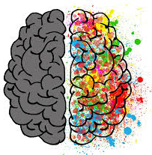
Task three (ALL):
You have been given two post-its each.
On one post-it you must write one personality trait of someone with a Growth Mindset and on the other, someone with a Fixed Mindset.
When you have done this, come and stick them on the split-brain poster on the wall.
Then – when everyone has done this, come back up and choose a trait you would like to work towards developing from the Growth side and one you would like to work towards being less like from the Fixed side.
Write what you have chosen in your log-book.
Giving
up easily
Resilience

Slide 9
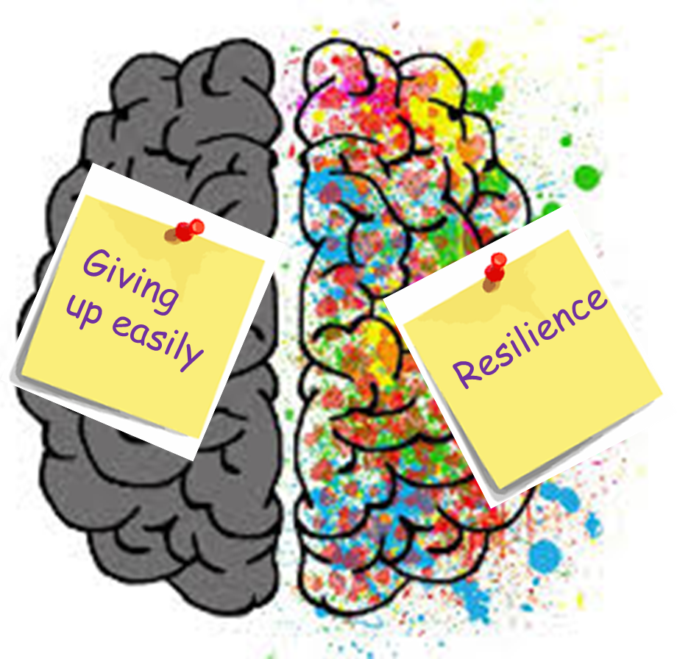
PLENARY
Challenge:
Using the two personality traits you have just picked, with a partner discuss one way you can try to be more like the Growth trait and less like the Fixed trait. E.g. Resilience - never give up after just one go.
More challenging:
Describe a situation in your book where you can actively apply your new Growth Mindset personality trait.
Mega challenge:
Explain how you could actively encourage your partner to achieve their Growth trait and move away from their Fixed trait.

