Slide 1
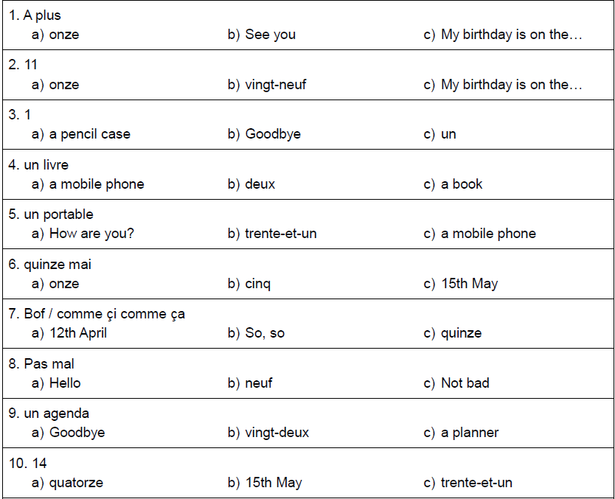
DO NOW
2)
1)
What do these questions mean?
Choose the correct letter for each word.
Quel âge as-tu?
C’est quand ton anniversaire?
3)
Can you answer them with French?
Quel âge as-tu?
C’est quand ton anniversaire?

Slide 2
DO NOW
2)
1)
What do these questions mean?
Choose the correct letter for each word.
How old are you?
When is your birthday?
3)
Can you answer them with French?
J’ai douze ans.
Mon anniversaire c’est le cinq mai

Slide 3
Classwork
Moi, je préfère le rouge, c’est cool.
L.O. | TO SAY WHAT COLOUR YOU LIKE / DISLIKE AND GIVE AN OPINION USING AN ADJECTIVE

Slide 4
rouge jaune noir blanc vert bleu marron gris rose orange violet | red yellow black white green blue brown grey pink orange purple

Slide 5
2 minutes pour apprendre
2 minutes to learn!

Slide 6
On the next slide, can you tell the colour of the word?
It’s trickier than you think!

Slide 7
jaune
rouge
vert
rose
violet
blanc
orange
bleu
noir

Slide 8
Which colour do you get when you add these colours together?
Jaune + bleu =
Blanc + rouge =
Bleu + rouge =
Rouge + jaune =
Noir + blanc =

Slide 9
Which colour do you get when you add these colours together?
Jaune + bleu = vert
Blanc + rouge = rose
Bleu + rouge = violet
Rouge + jaune = orange
Noir + blanc = gris

Slide 10
Un crayon bleu
Objectives:
say what colour something is
learn how to use adjectives in French

Slide 11
AGREEMENT OF ADJECTIVES (1)
The singular
An adjective is a describing word: it describes a noun.
Adjectives of colour for example tell you what colour something is:
rouge blanc bleu vert jaune noir gris rose orange marron

Slide 12
In French adjectives come after the noun they are describing:
un livre bleu - a blue book (literally, a book blue)
When they are used after a feminine noun you should add an 'e' at the end of the adjective.
une gomme bleue - a blue rubber
If the adjective already has an 'e' at the end then you do not need to add another 'e'.
une règle rouge - a red ruler

Slide 13
 Please watch out for these exceptions:
blanc (white) – blanche
marron (brown) - marron (it never changes)
You can also apply these rules to other adjectives like nationalities.

Slide 14
Fill in the blanks in the following table of colour adjectives.
Couleur | masculin | féminin
blue red green grey black pink brown white | bleu rouge vert gris noir rose marron blanc | bleue

Slide 15
Fill in the blanks in the following table of colour adjectives.
Couleur | masculin | féminin
blue red green grey black pink brown white | bleu rouge vert gris noir rose marron blanc | bleue rouge verte grise noire rose marron blanche

Slide 16
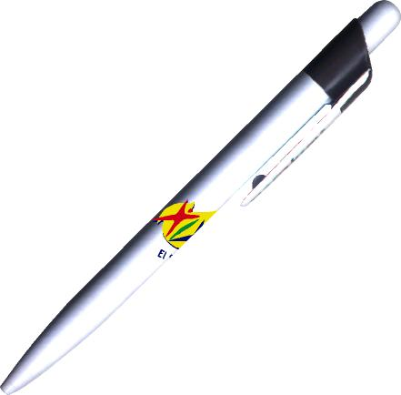
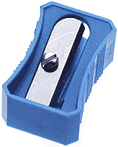
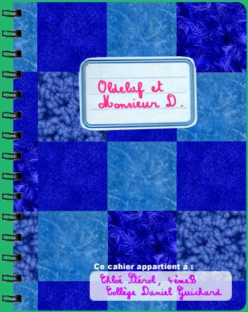
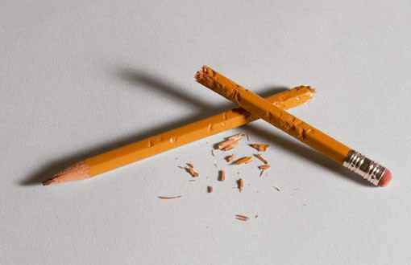
Make a list of what is in your pencil case! Don’t forget that the adjective (the colour) goes AFTER the noun (the object)
un taille-crayon bleu.

Slide 17
Some adjectives are masculine (blue circle) or feminine (pink circle) and some are the same for both (overlapped circle).
Vert
rouge
Verte

Slide 18
bleu
noir
bleue
Can you put these adjectives in the correct area?
jaune
gris
grise
noire
orange

Slide 19
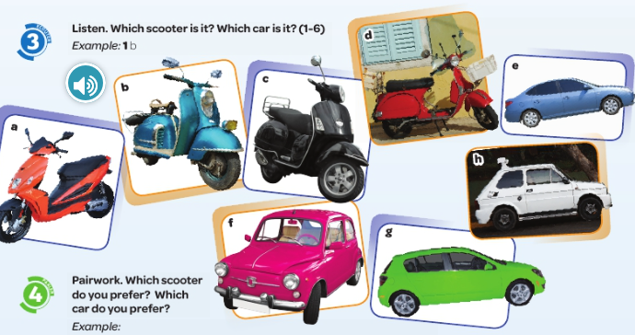
Speaking / writing
Write which 2 scooters and which 2 cars you prefer. Look at the example first!

Slide 20
DEVOIRS – HOMEWORK

Slide 21
Fill in the blanks with the correct adjective, remember to look if the noun is masculine or feminine.
une trousse _____(green)
un crayon _____(blue)
une gomme _____(red)
un taille-crayon __________(black)
une règle ________ (white)
Now describe the content of your pencil case, saying what colour each item is. Use the vocabulary in your vocab. book!

