Slide 1
Do Now

Slide 4
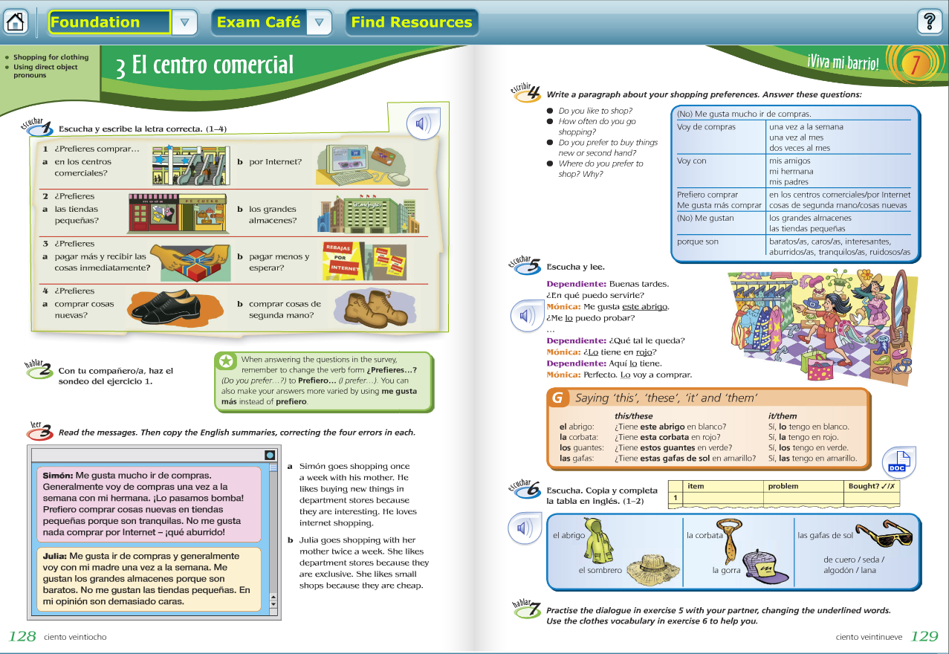

Slide 5
Homework

Slide 6
