Slide 1


Do now task
How much can you remember?
How are tropical storms measured?
How would tourism in the UK change due to climate change?
What does interdependence mean?
What is the brain drain?
Pencil cases out
Conduct cards in pencil cases
Coats and bags off

Slide 2
Risking it
L.O To know why people live in areas at risk of tectonic hazards

Slide 3
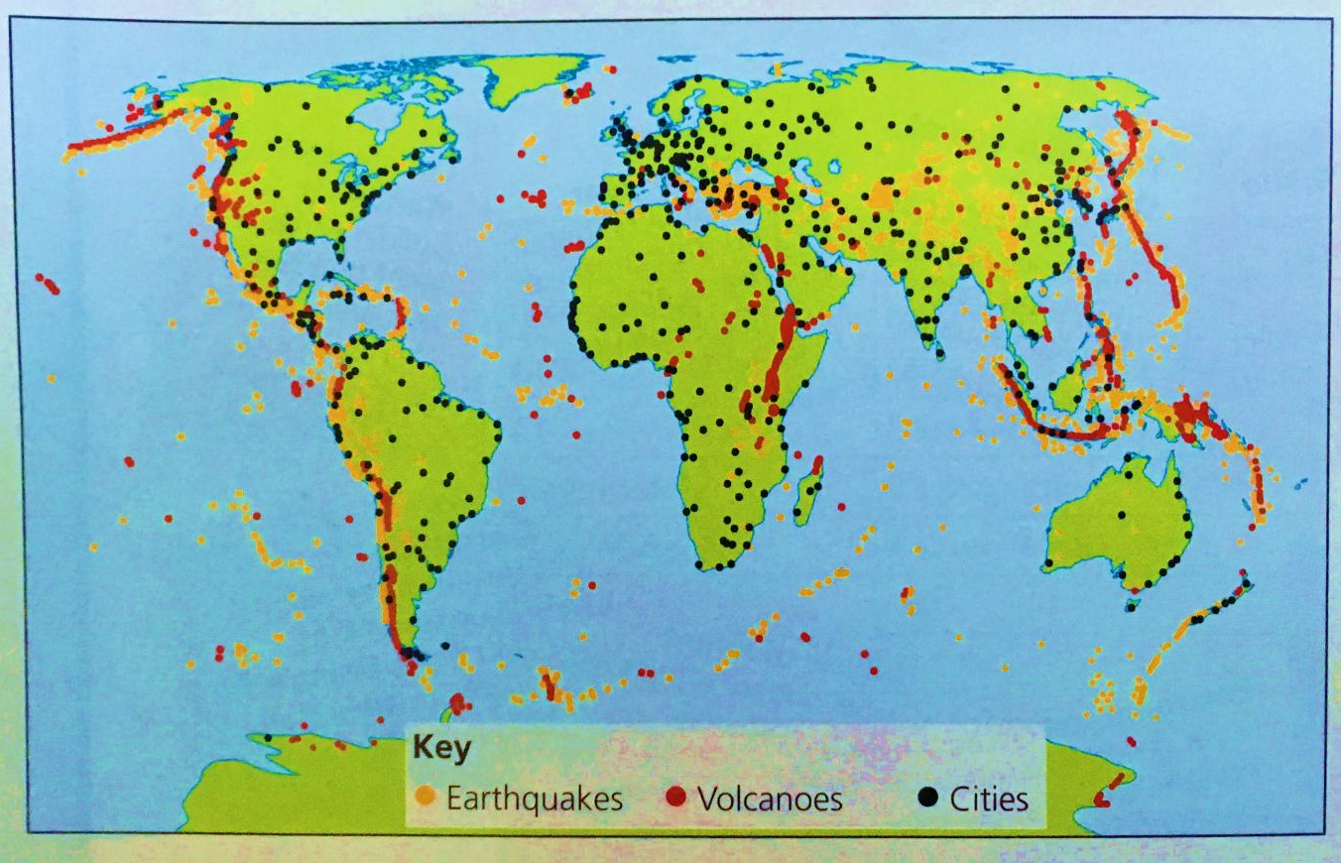
Do people live near tectonic hazards?
As the worlds population increases, more people are will live in volcanic and earthquake prone areas.

Slide 4
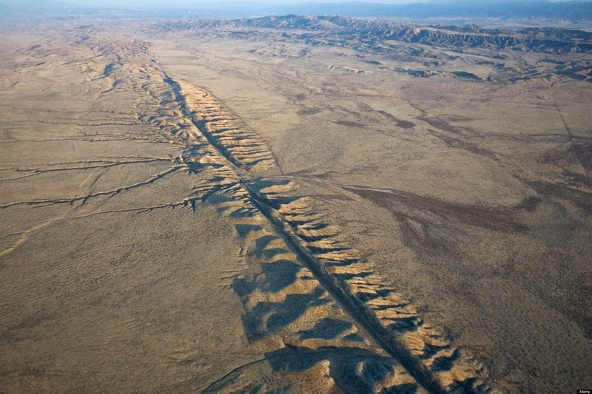
Approximately 8% of the 7 billion people who live in the world live near volcanoes.
About 50% of the 320 million people in the USA are living at risks of earthquakes.
Why?
Mid-Atlantic Ridge, California

Slide 5
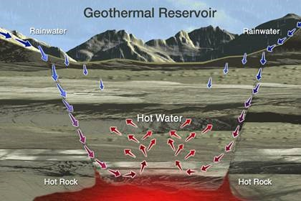
Geothermal energy
Geothermal energy is a major source of electrical power.
Steam is heated by hot magma, the steam is used to turn turbines at power stations. This is renewable energy: meaning it will never run out.

Slide 6
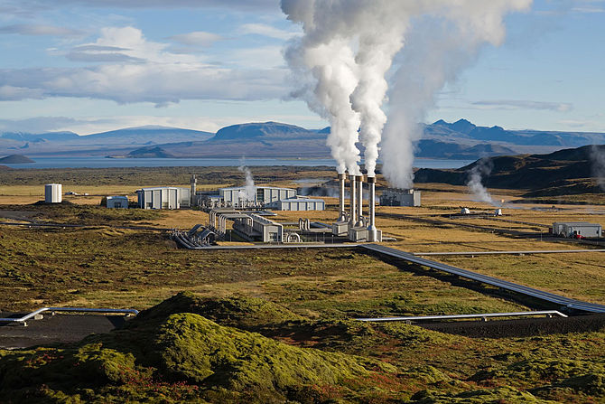
Hellisheidi, Iceland
Largest power station in Iceland
Second largest in the world
Provides hot water and electricity for Iceland's capital, Reykjavik
Provides abut 30% of Iceland total electricity.

Slide 7

Farming
Ash and lava from erupting volcanoes kill livestock and destroy crops and vegetation.
After thousands of years, weathering of this lava has released minerals which in turn gives us extremely fertile soil, rich in nutrients.

Slide 8
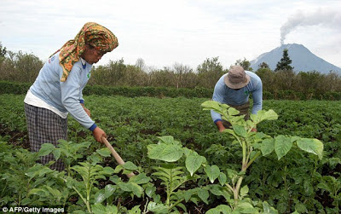
Land can then be farmed productively providing a source of income.
Volcanic soils are found on less than 1% of the earths surface BUT it supports 10% of the worlds population.

Slide 9
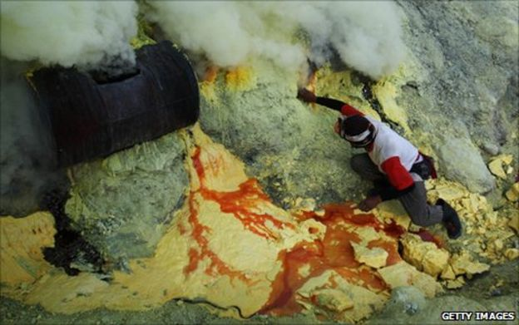
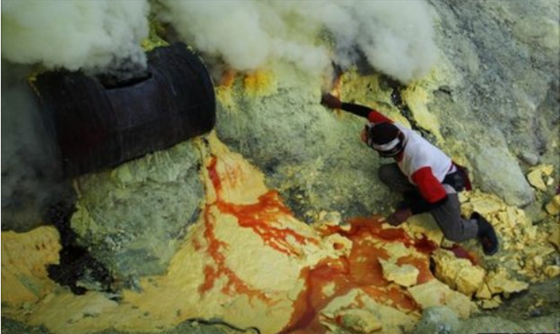
Mining
Settlements develop where valuable minerals are found as jobs are created in the mining industry. Dormant (sleeping) extinct volcanoes are mined as well as active volcanoes.
Kawah Ljen, Indonesia is an active volcano. It has the biggest sulphuric lakes in the world. Sulphur is sold to bleach sugar, make matches, medicines and fertilisers.

Slide 10
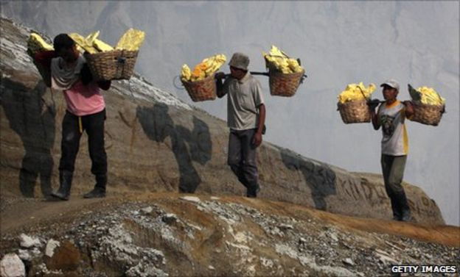
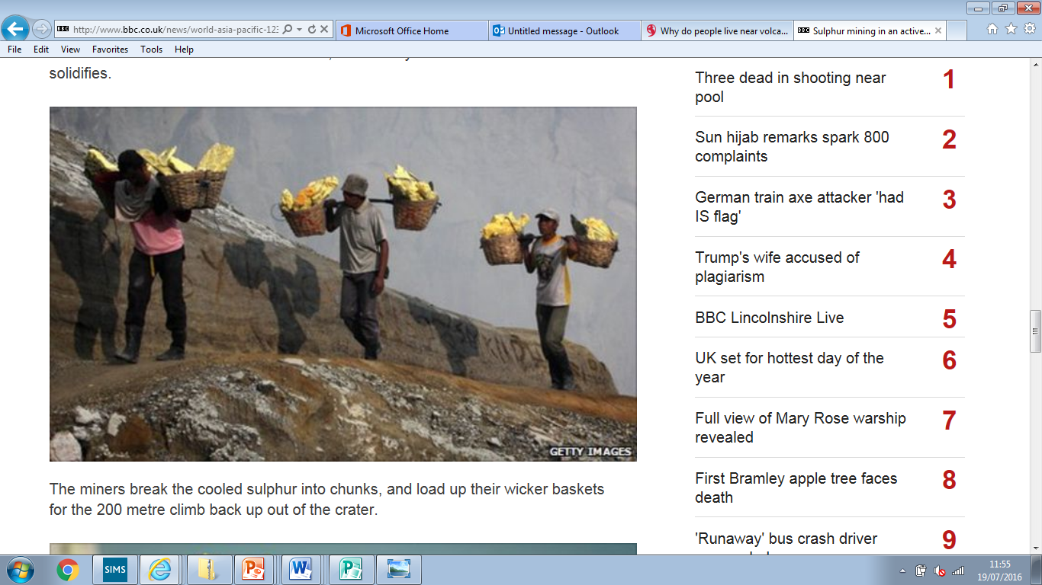
Mining can be very dangerous. Miners have little protective clothing , sulphur dioxide can burn their eyes and throats. In the last 40 years 74 mines have died from the fumes.
Nevertheless, miners can earn an average of $6 per day, more than coffee plantation workers. So miners continue to live and work in these dangerous areas.

Slide 11
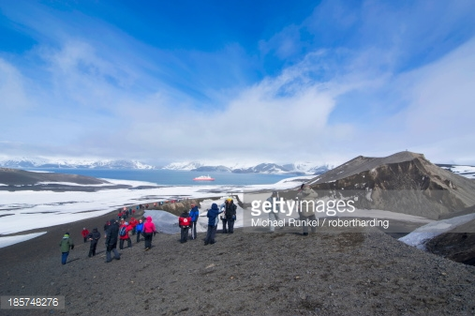
Tourism
Tourists visit volcanoes for the spectacular and unique views , relaxing hot springs, adventure and for thrill seekers.
More than 100 million people visit volcanic sites each year.
The revenue (money) they generate benefits the locals and the counties they are in.

Slide 12
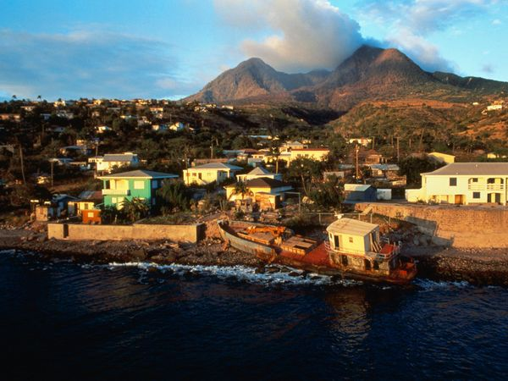
Family, friends and feelings
People don’t want to leave because their friends and family are there.
It is often cheaper to stay
Some people believe the risks are not dangerous enough, or residents are in denial that a disaster may occur.

Slide 13
Using the table and cart sort on the separate files categorise the statements into Economic environmental and social reason why people live by volcanic hazards.

Slide 14
You must now decide which of these factors are the most important economic, social and environmental factor on why people live by tectonic hazards. Justify your answer.
The most influential environmental factor is ………………. this is because ………………
The most influential social factor is ………………. this is because ………………
The most influential econmic factor is ………………. this is because ………………

